Slide 1

The School Voice Process

Slide 2
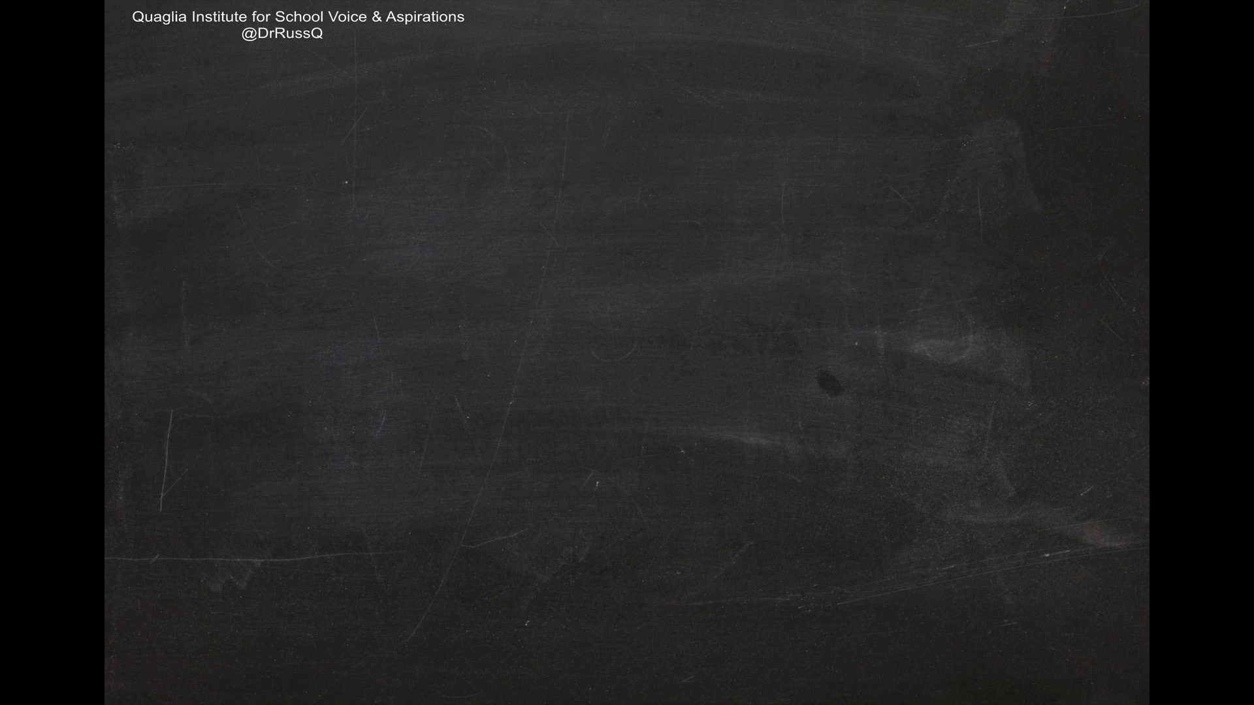
School Voice Model
Special thanks to Dr. Corso, former Chief Academic Officer of the Quaglia Institute for his presentation of the process.
Play Video

Slide 3
LEAD
TAKE ACTION
with others
Share
RESPONSIBILITY
LEARN
UNDERSTAND
& RESPECT
different points
of view
Build
TRUST
LISTEN
SEEK OUT
opinions from
others
Student Voice Process

Slide 4
For more information visit
QuagliaInstitute.org
Voice Process

