Slide 1

Northridge Academy High School
Sit With Wisdom

Slide 2
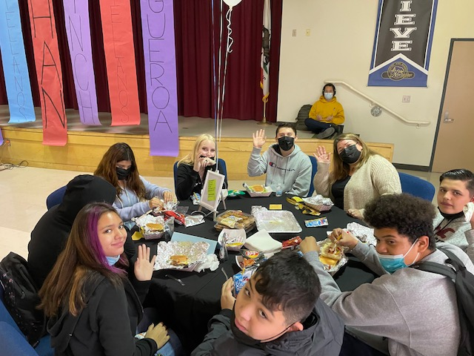
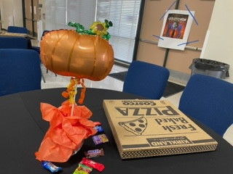
“The Aspirations Team at Northridge Academy High School has been laser focused on establishing a school culture where students know they belong to their school “family” and that the voice of every individual student is valued and heard. Sit With Wisdom is one example of the many actions we have taken toward achieving this goal. Students are strategically selected to enjoy a catered lunch with one of their teachers (approximately 8 students per teacher). The “wisdom” component stems from the knowledge and experiences that students share with the teacher seated at their decorated, prom-style table.”
– Jason Black, Teacher

Slide 3
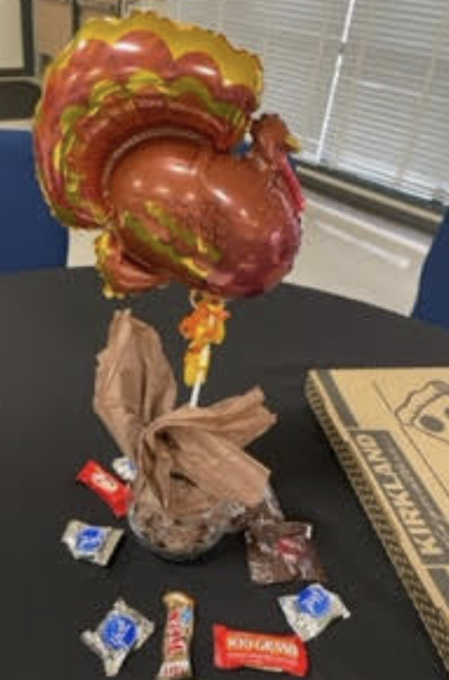
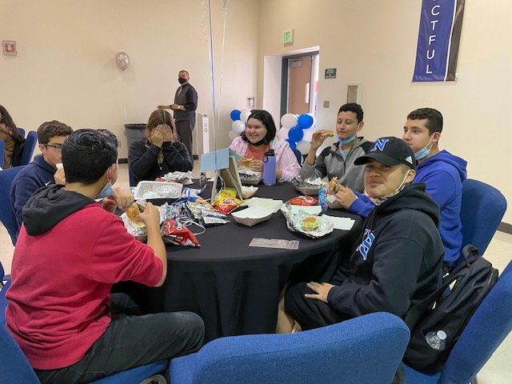
“The general vibe of a Sit With Wisdom lunch involves the purposeful stripping away of traditional boundaries inherent in the student-teacher relationship in
order for all parties to exist on the same plane for a brief moment in time. That
brief moment becomes a priceless opportunity for students to build a lifetime of
connections with their teachers by sitting with them, eye-to-eye, eating the same food, smiling as they bite into generous portions of ice cream or other frozen
treats, and sharing wisdom with one another. Sit With Wisdom is an important
time when students can actually “see” their teachers as allies in their pursuit of personal success. The wisdom that is shared between teachers and students
during these Sit With Wisdom lunches continues to positively impact our school culture and sustain our support for one another as a community of learners—
the NAHS family.” – Jason Black, Teacher

Slide 4
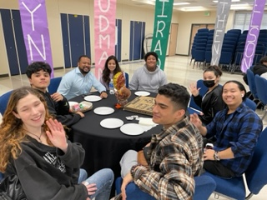
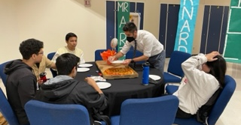
“Sit With Wisdom is so beneficial for the social emotional needs of our students because they get to spend some time with their teacher in an environment that is different from the classroom. This event affords teachers the opportunity to get to know the students in a deeper manner. The time together is about them getting to know each other on a more personal basis. The students feel so special to be invited to have a nice lunch with their teacher. There are some teachers who bring special gifts to the kids. Others bring games in case the kids do not feel comfortable with just conversation. For me, this event is so amazing because I get to see kids happy and safe.” –Nidia Castro, Principal

