Slide 1

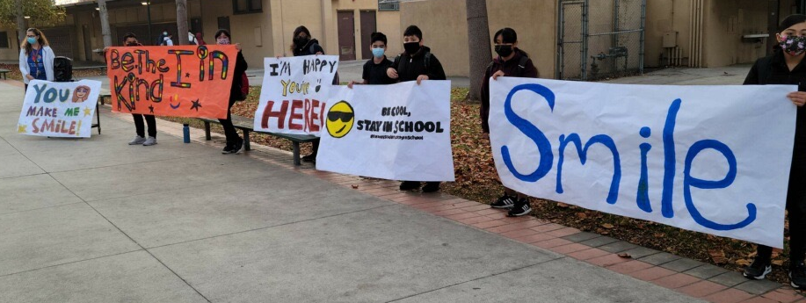

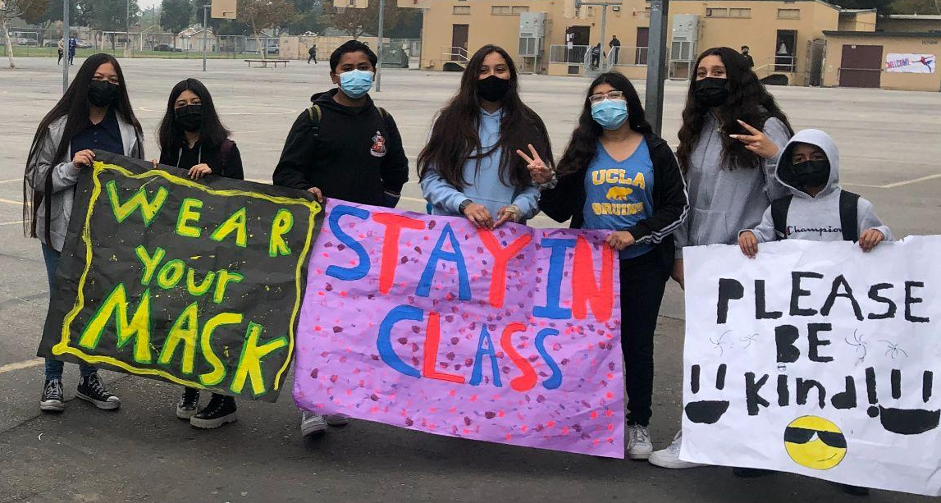
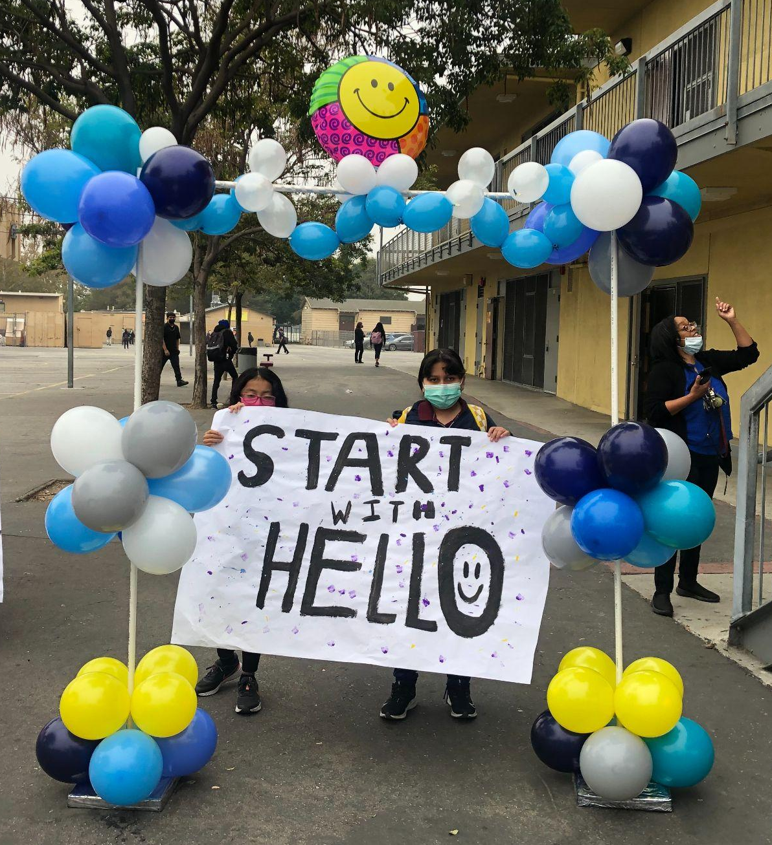
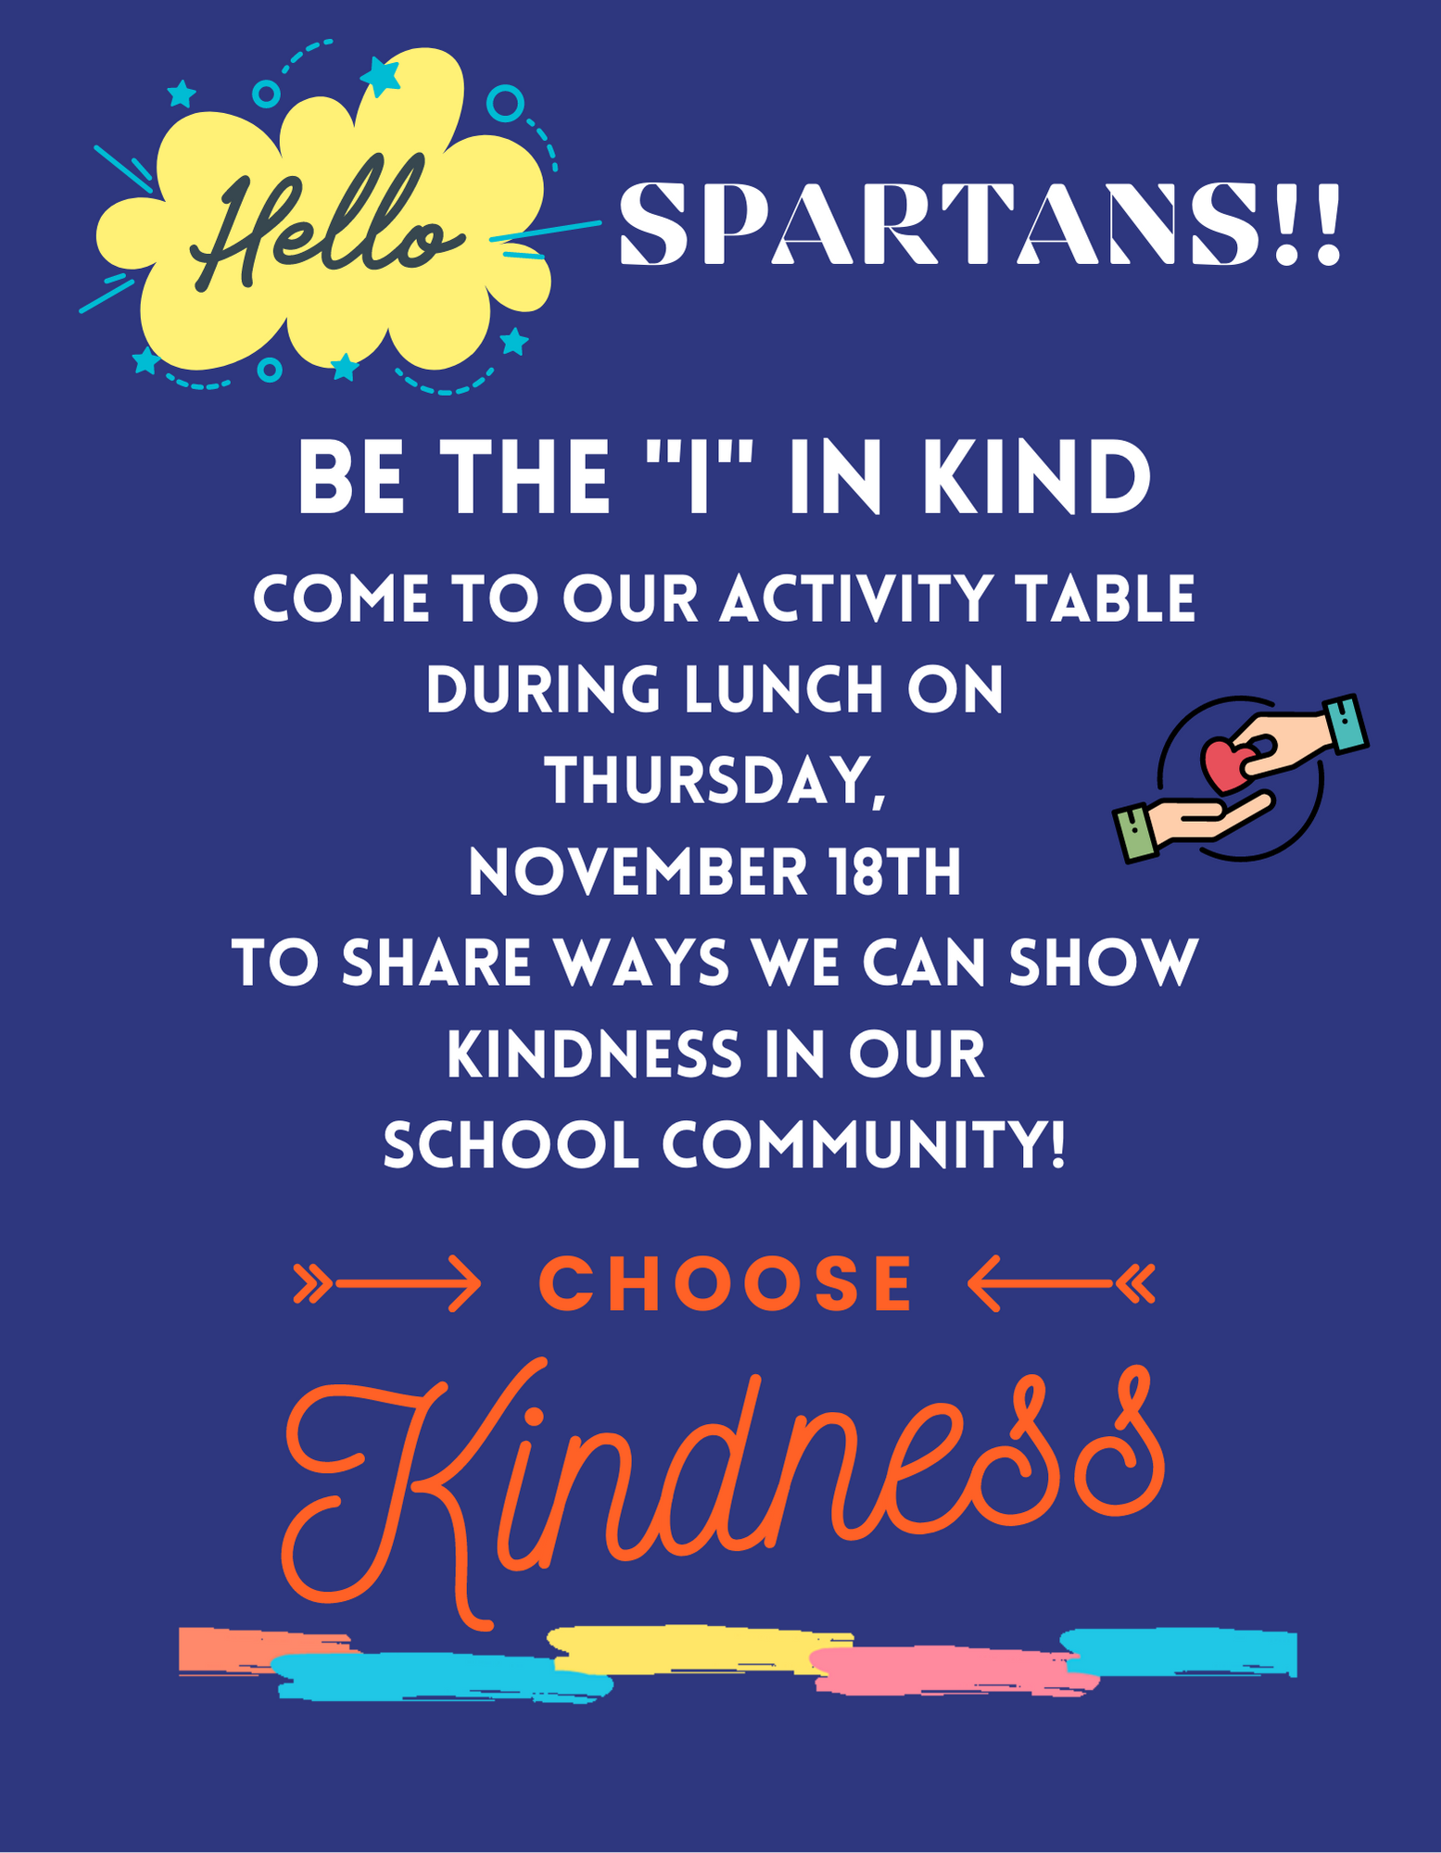
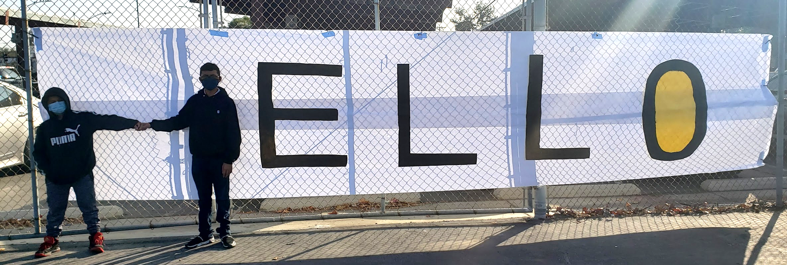
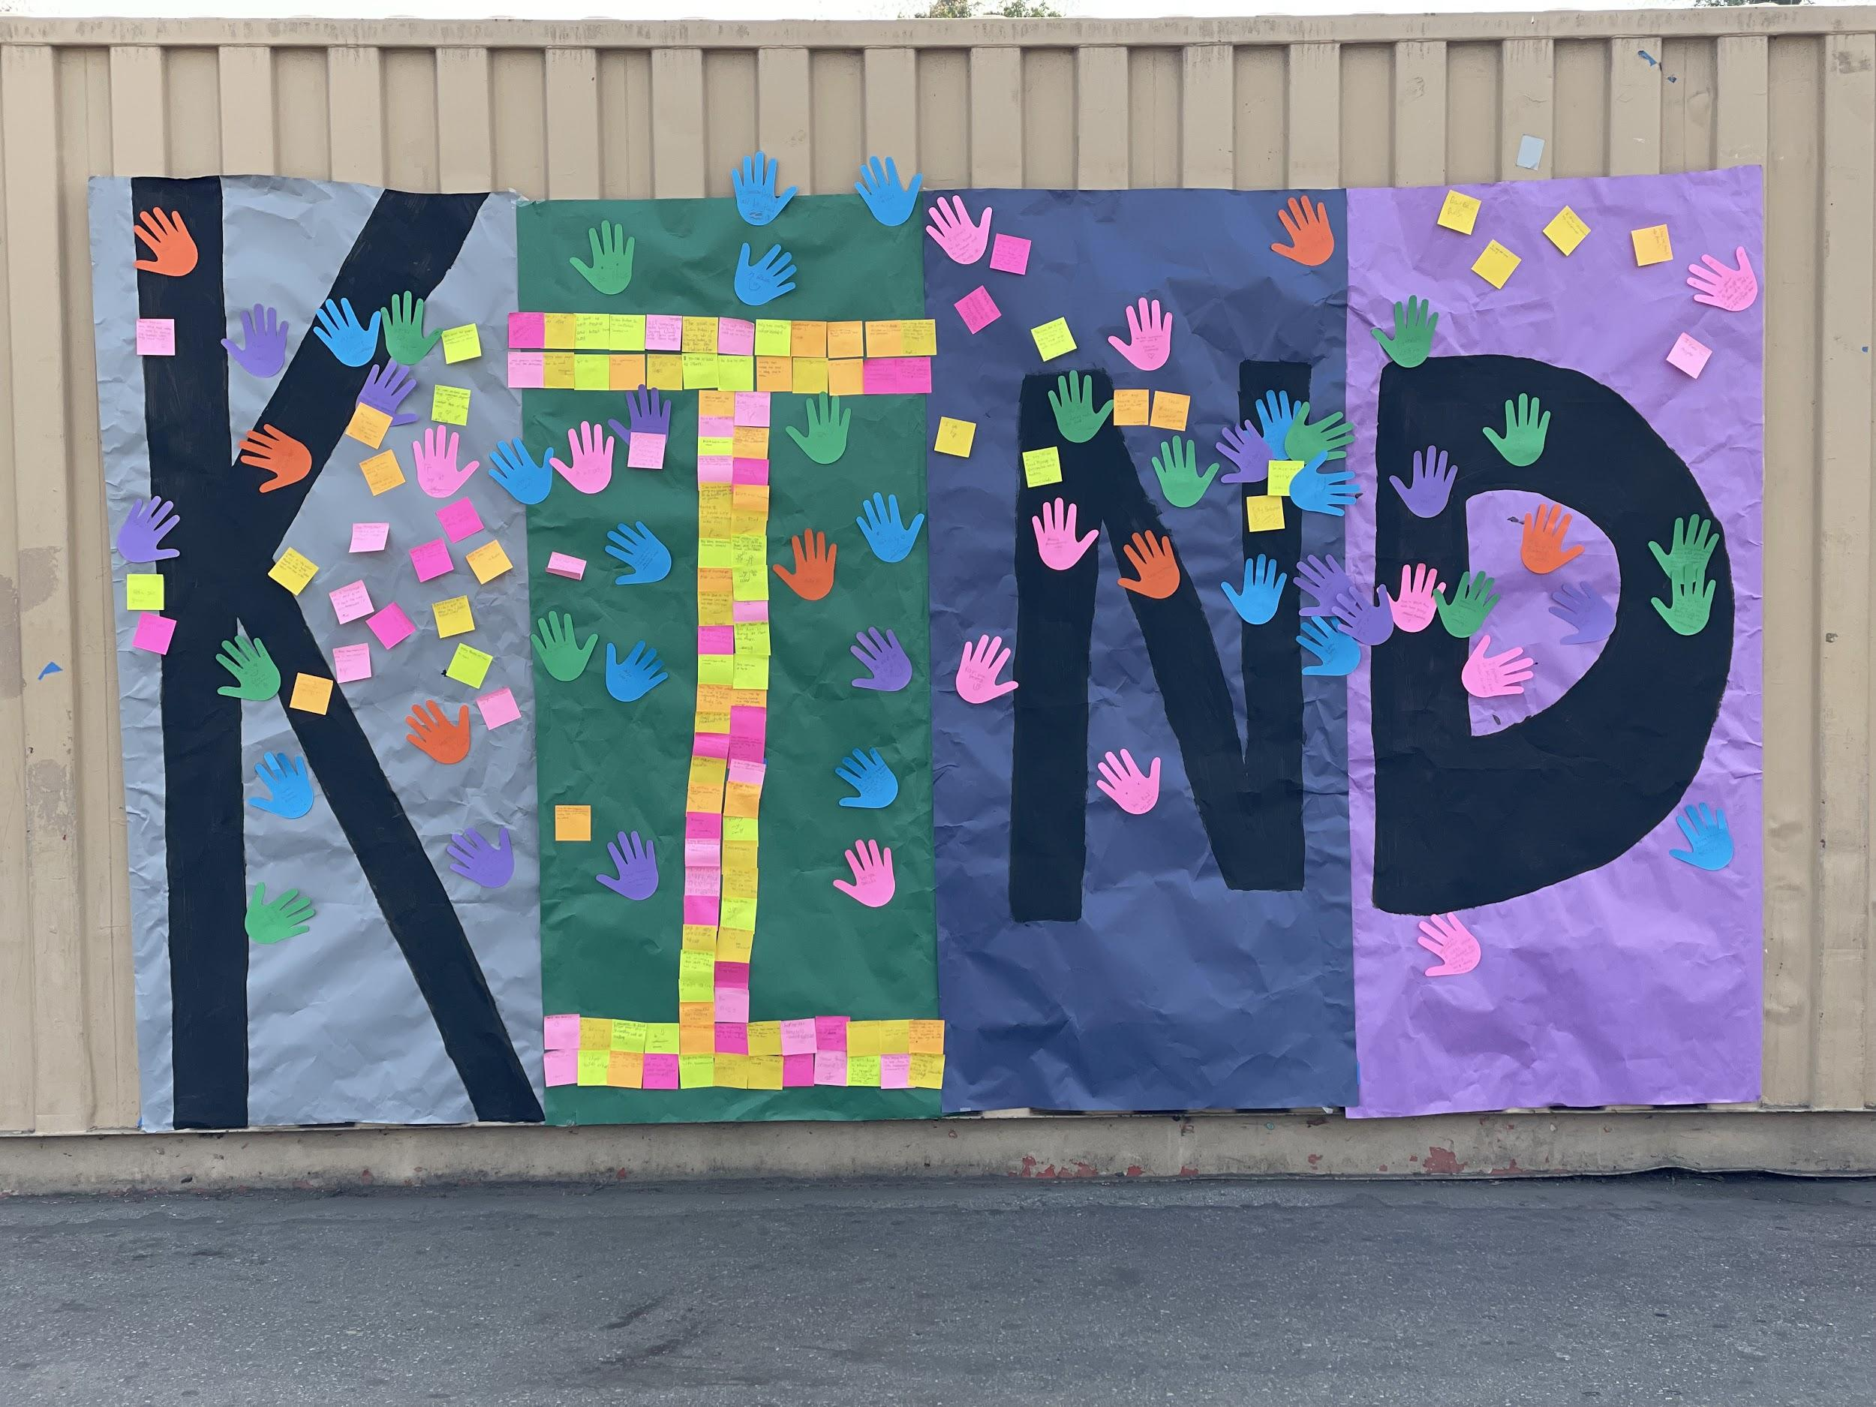
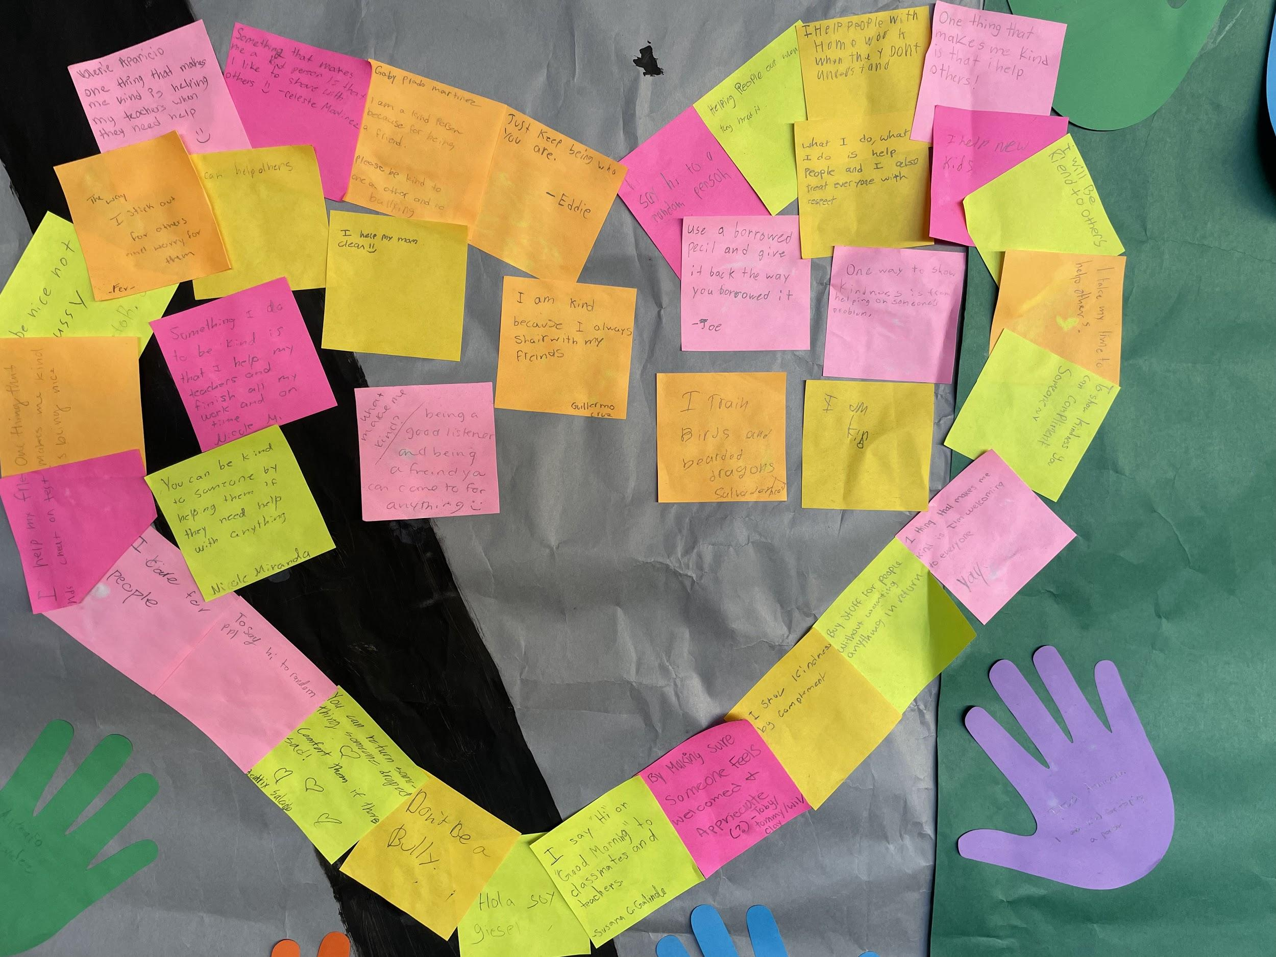
Henry T. Gage Middle School
This fall our focus was on helping students develop a sense of belonging and connection to our school, our staff, and their peers.
Students participated in a Start With Hello Presentation from Sandy Hook Promise. Through this violence prevention program, students were taught how to recognize when another student is alone, ways they can reach out and help lonely or socially isolated students, and different strategies to connect with other students to build a socially inclusive school community.
This schoolwide presentation kicked off a Spirit Week that included student volunteers greeting their peers at the morning entrance gates and a lunchtime activity that invited students to voice their ideas of ways we can show kindness in school and display them on a community banner.
We also had classes meet up outside in the morning, introduce themselves to each other, and participate in a getting-to-know-you activity which included our teachers.
A student club will be promoted to empower students in taking a proactive role in shaping school culture next semester.
Fall 2021

Slide 2
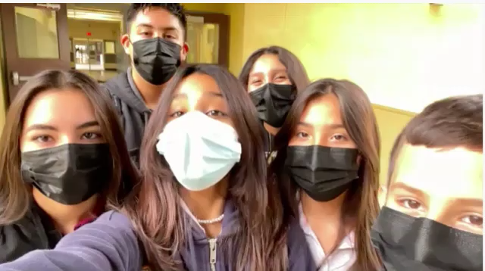
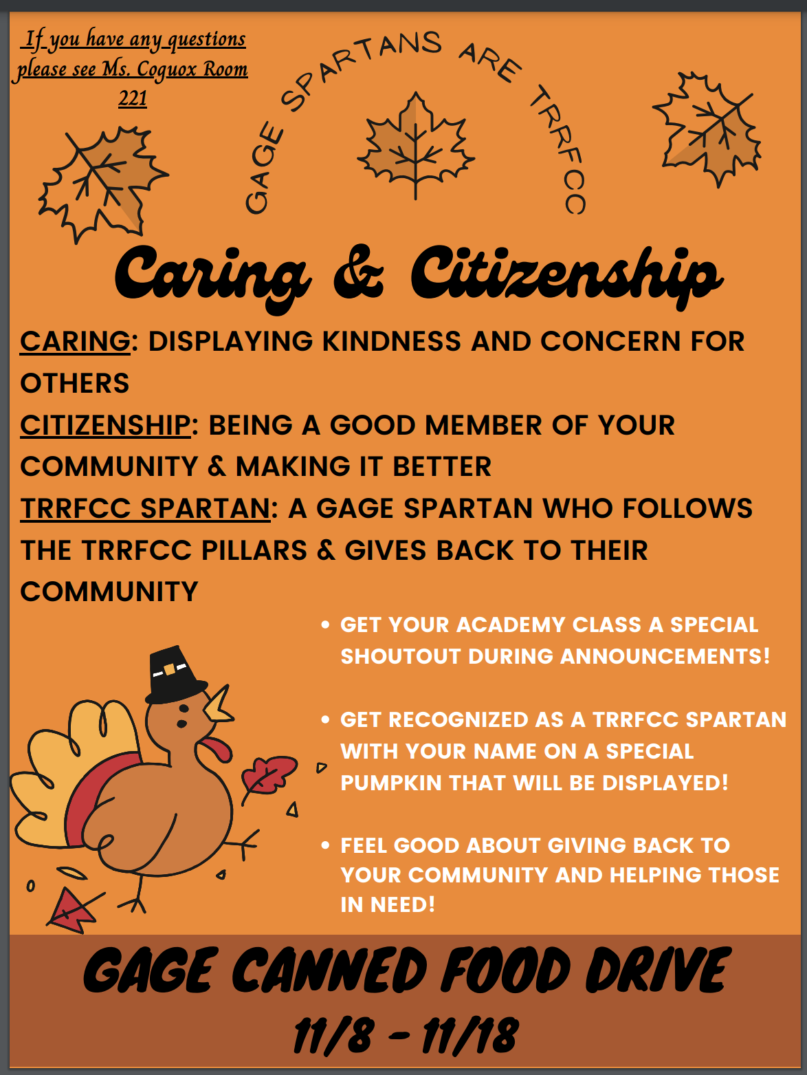
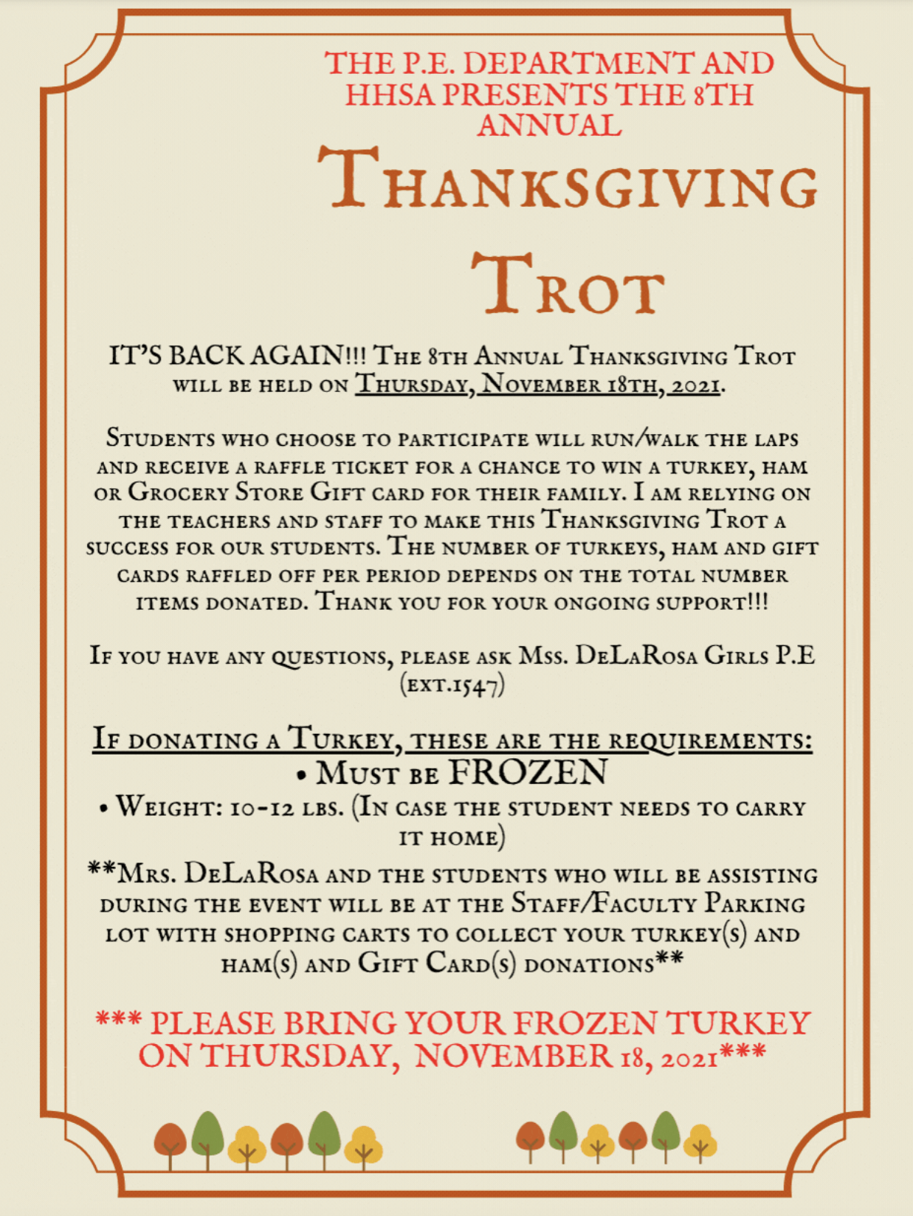

Henry T. Gage Middle School
This fall numerous faculty and staff members also collaborated to bring even more unifying opportunities for our students and community. These experiences allowed us to work together for the good of the whole.
Character Counts Assembly
Administrators, teachers, and staff members recorded a video message highlighting the six pillars of character to raise awareness and build connection with the adults on campus. This was presented in classrooms via a virtual assembly during Academy/Homeroom class. Leadership students then followed up by creating their own video sharing ways the pillars of character can be demonstrated in our school community.
Canned Food Drive
A canned food drive was organized by the Health and Human Services Academy lead teacher that involved student helpers and student contributions for the Salvation Army prior to Thanksgiving.
Thanksgiving Trot
Our P.E. teachers organized a Thanksgiving Trot for students. Students ran/walked in P.E. class to enter a raffle to win turkeys, ham and grocery gift cards. Faculty and staff joined forces to donate for our students’ families.
Toy Drive
Currently, a couple of our amazing teachers are running a Toy Drive to support families in need from our school community. The entire Spartan community can donate toys.

