Slide 1
Northridge Academy High School - Legacy Project:
“Strengthening our NAHS Family”

Slide 2
In 2017, our school realized a social emotional need to build the
self-efficacy and social awareness of our students.

Slide 3
Through our new partnership with
The Quaglia Institute, we realized that
everything we do makes us feel like a family.

Slide 4
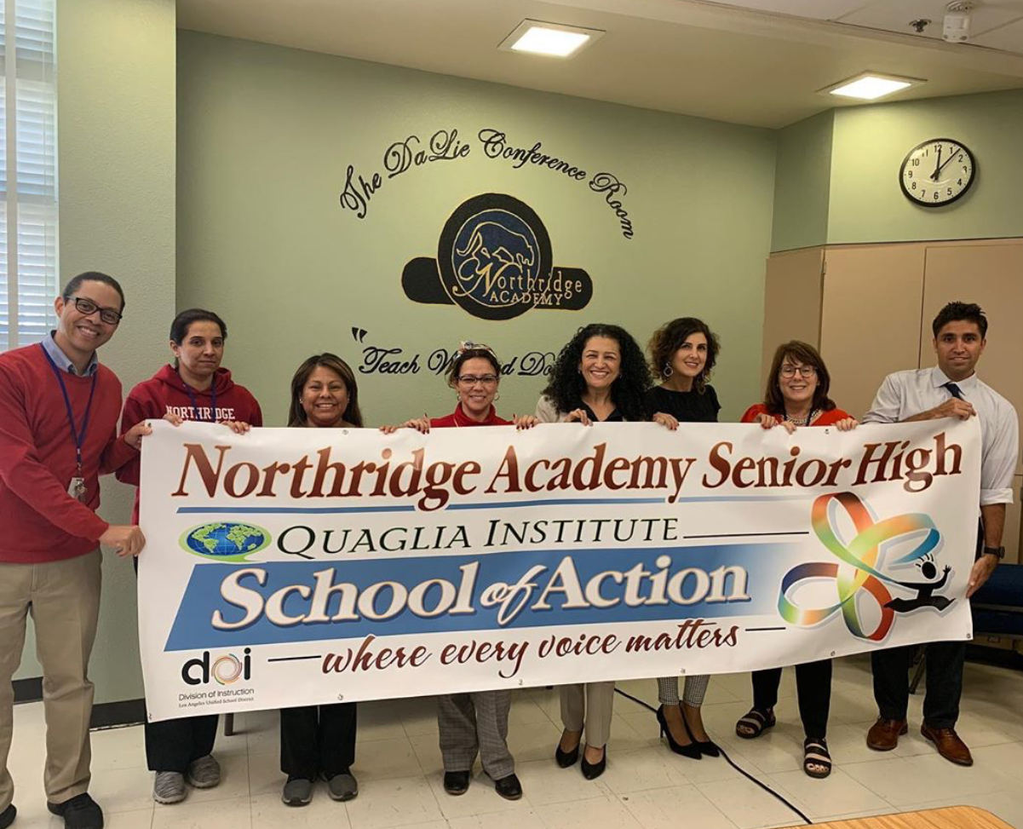
This is our Quaglia Team
Family.

Slide 5
We decided to start building upon this idea of family by establishing a NAHS tradition:
Grade-level breakfast gatherings.

Slide 6
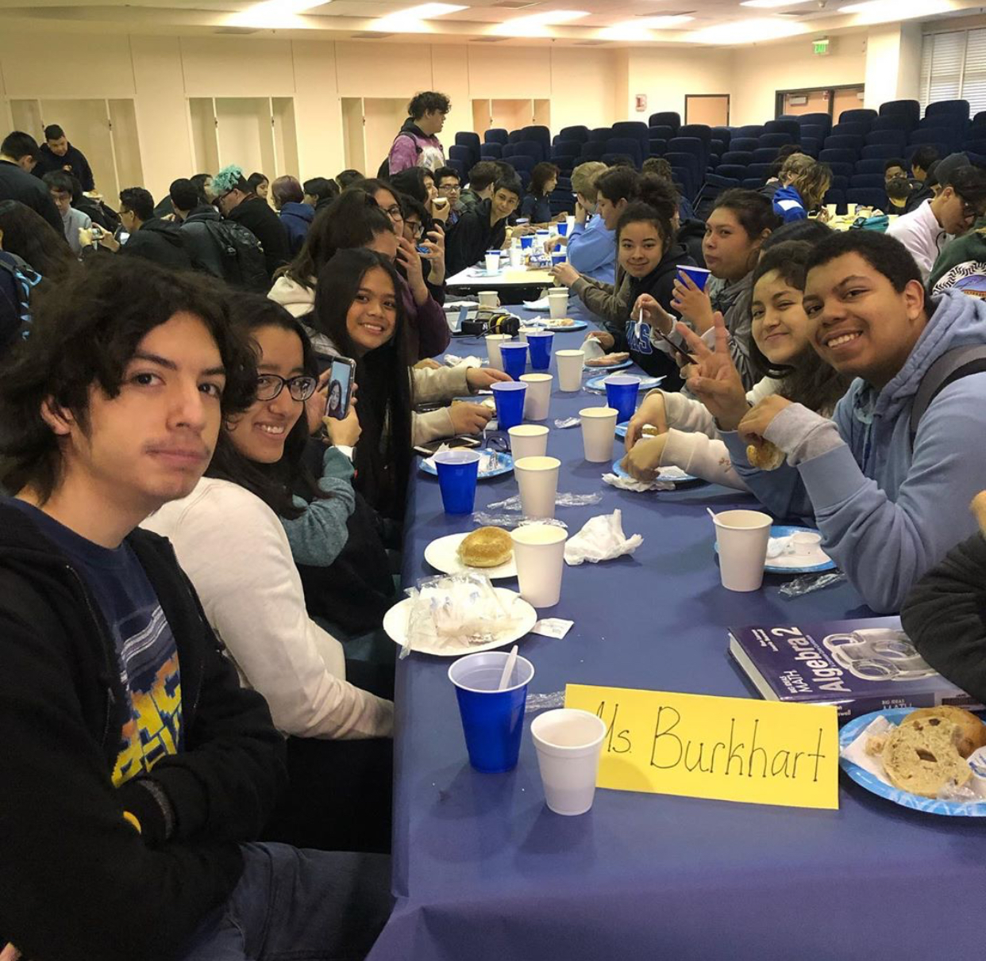
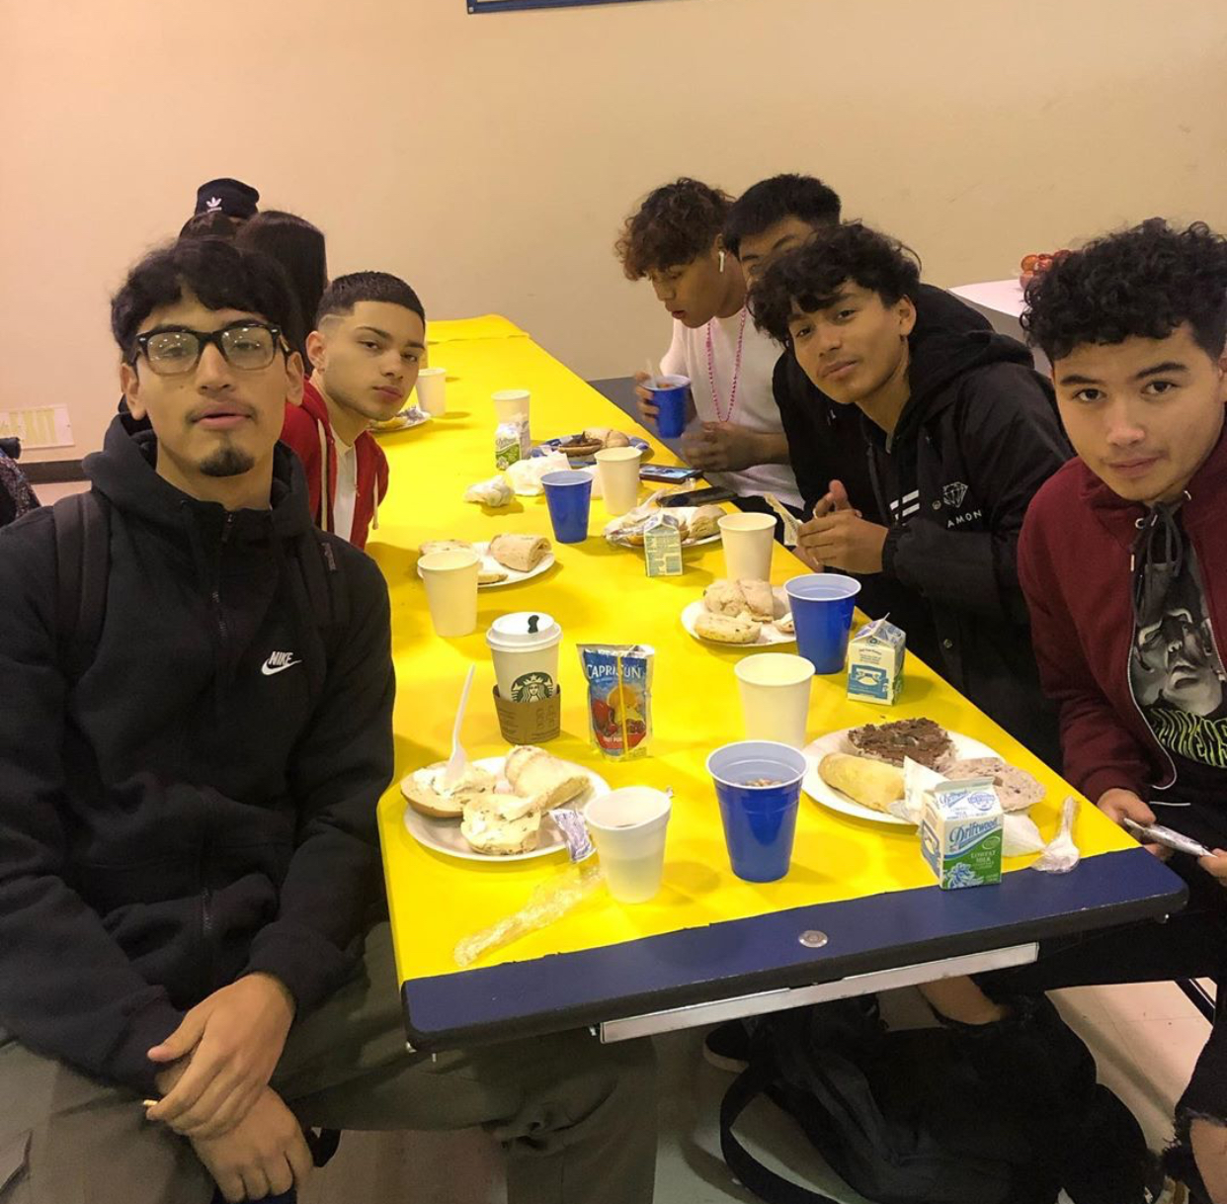
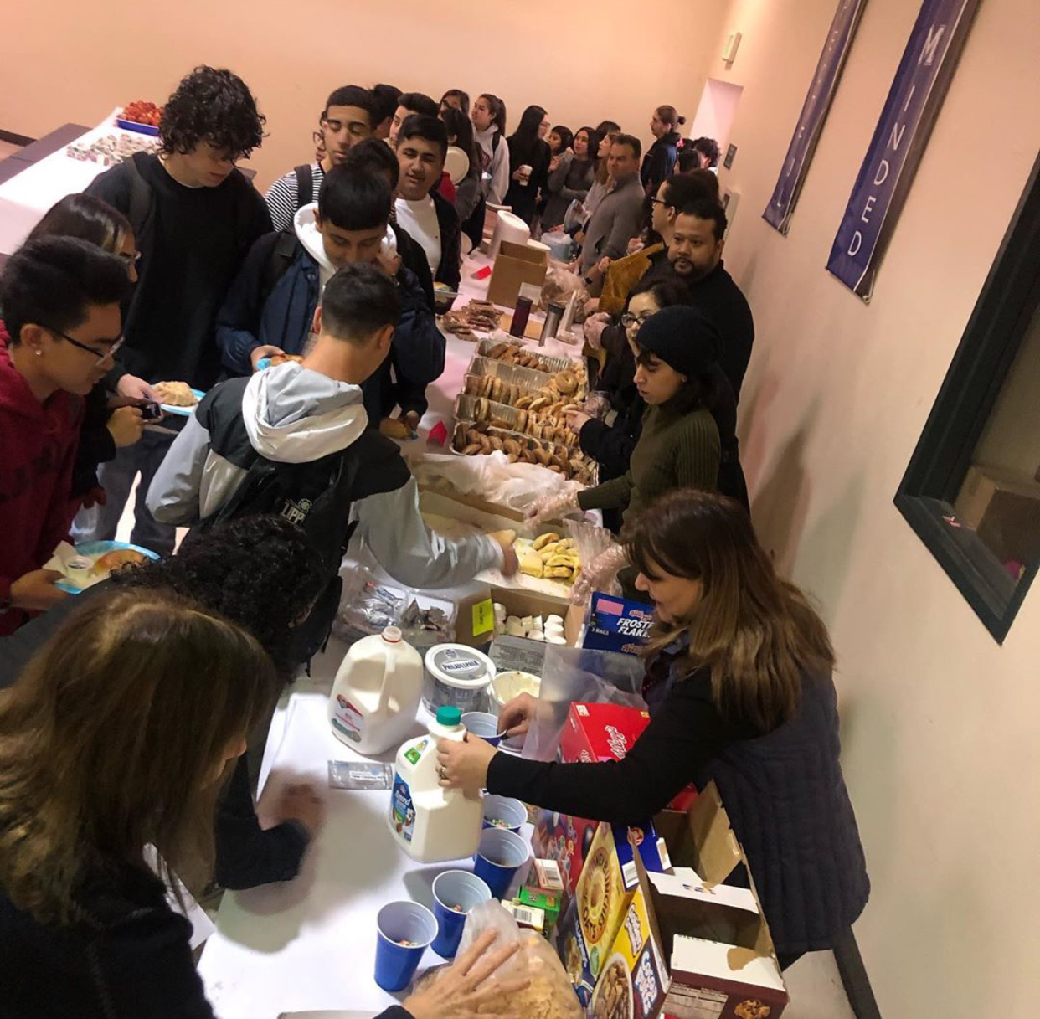
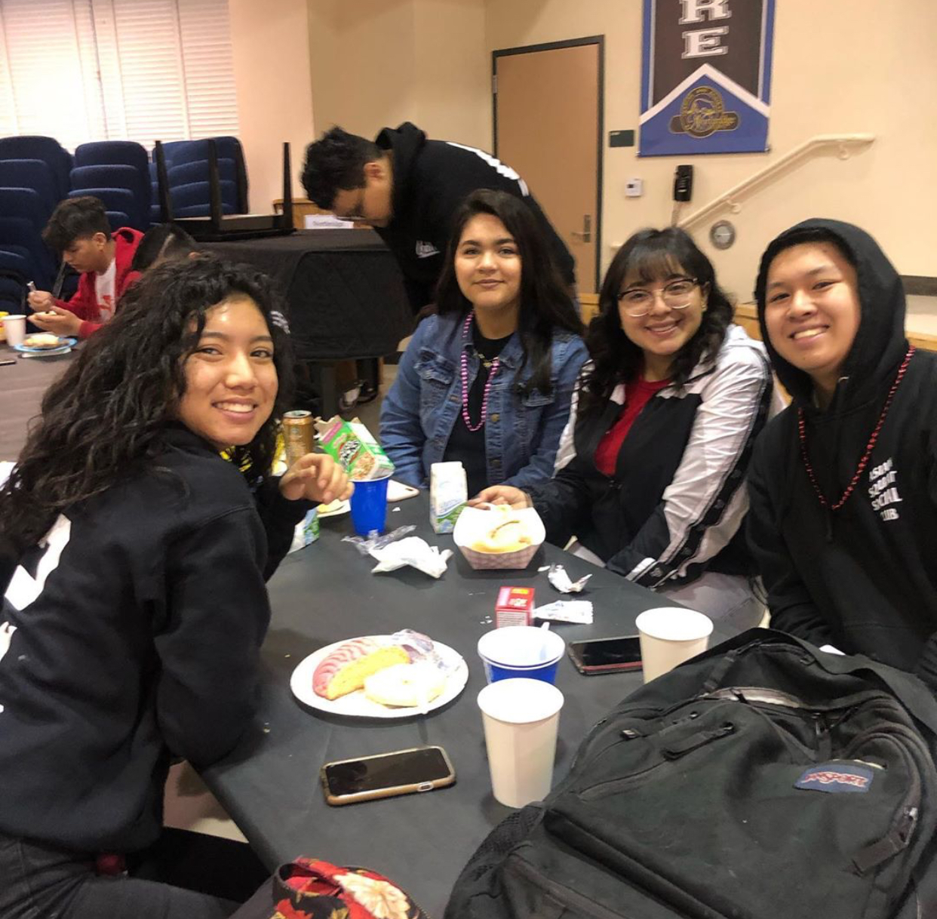
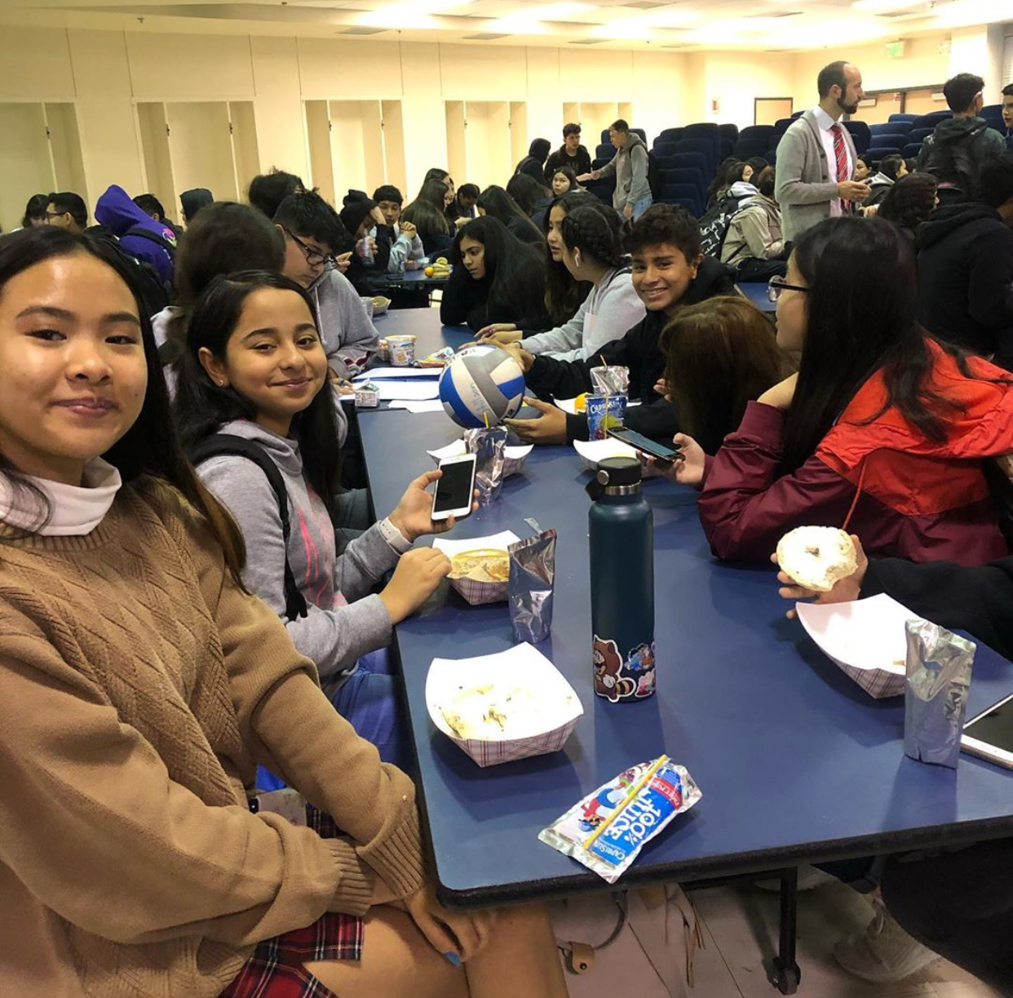
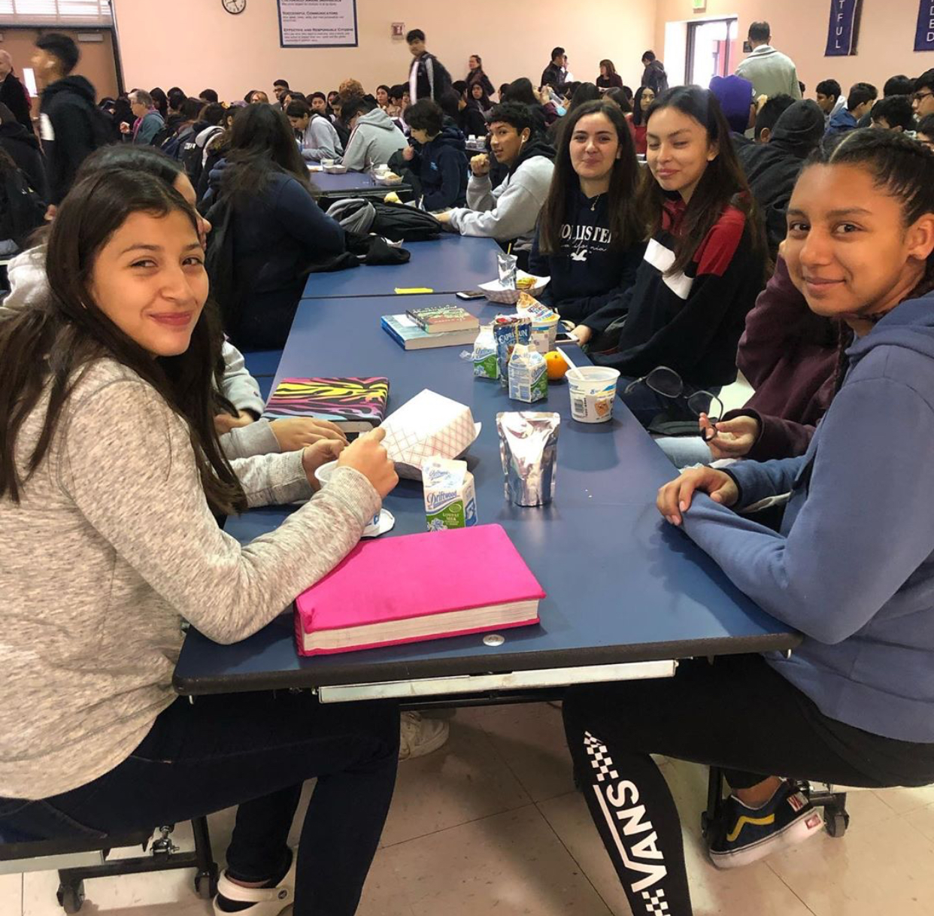

Slide 7
We called them
“The Breakfast Clubs”

Slide 8
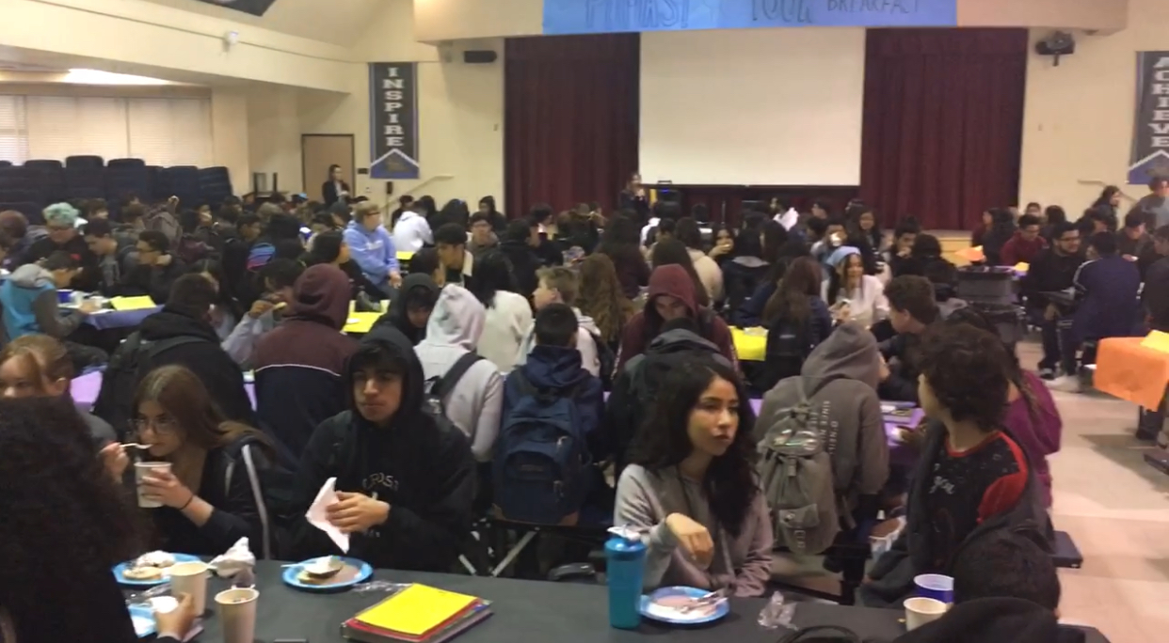
Teachers brought breakfast items.
Students sat by their Advisory (homeroom) classes.
It felt like home.
It felt like a family.

Slide 9
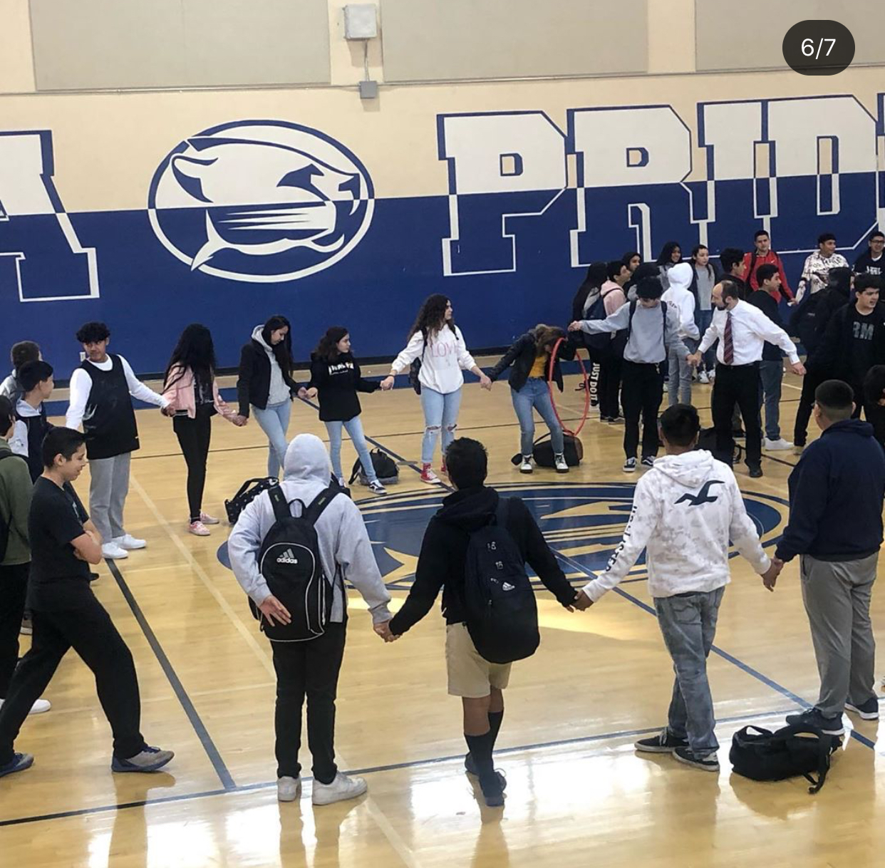
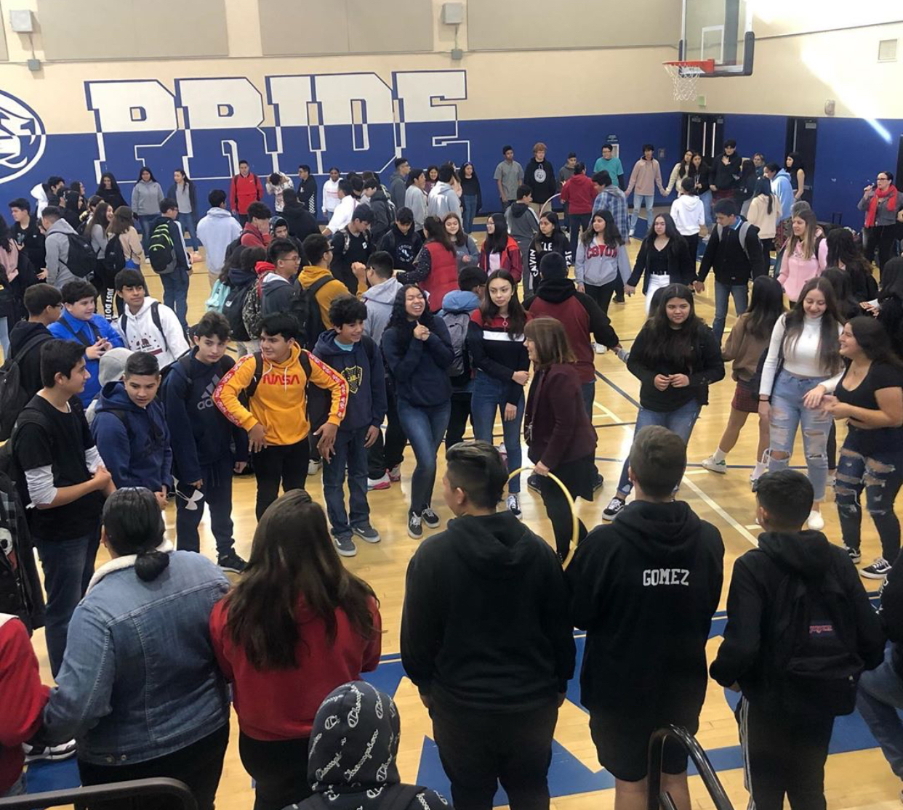
How did we make the family feel even closer?
After breakfast, our family groups transitioned to the gym where we engaged in a number of very fun, high-energy team-building activities.

Slide 10
Students commented that they enjoyed the time they were allowed to connect with their classmates. They asked if we could do it again!
A new school tradition is born!

Slide 11
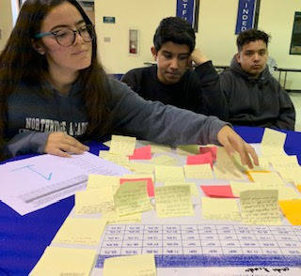
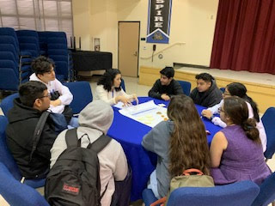
In addition to the Breakfast Clubs,
we held our first of many World Cafes.
At this event. we sat within teams to address and discuss all of the daily issues that students feel are the most important.

Slide 12
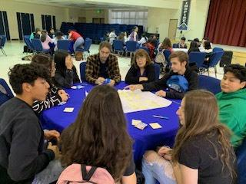
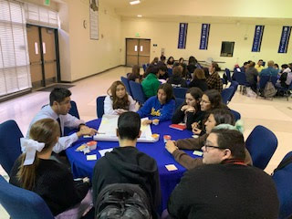
The World Cafe helped teachers view the school from a student’s perspective.
This will be another new tradition at Northridge Academy High School.

Slide 13
We enjoyed hearing our students’ voices at the World Cafe so much that we invited them to speak at one of our faculty PDs.

Slide 14
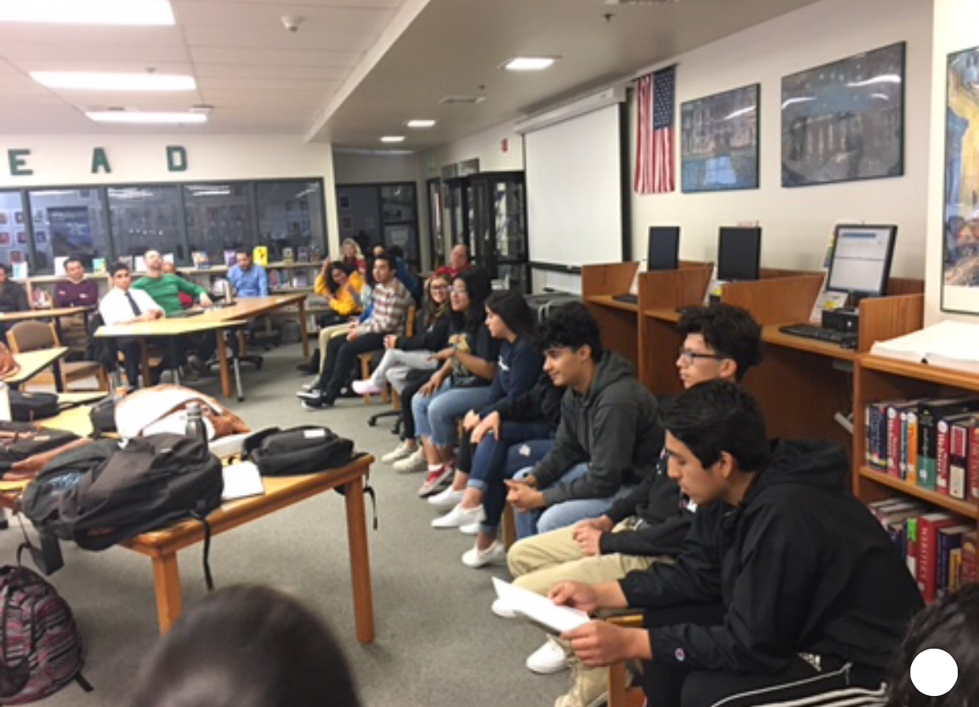

Slide 15
The students freely spoke and their voices will continue to echo and to inform teacher planning.
As a new tradition, their thoughts and feelings will continue to inspire institutional efforts toward building a better, stronger and more reflective community.

Slide 16
Our Legacy project conclusion
We learned that our legacy centers on the notion of family.
We are strong when we do things with this in mind.
We will continue to enjoy time together, eat together, and reflect on how we can make our time here even better as one big Puma family.

Slide 17
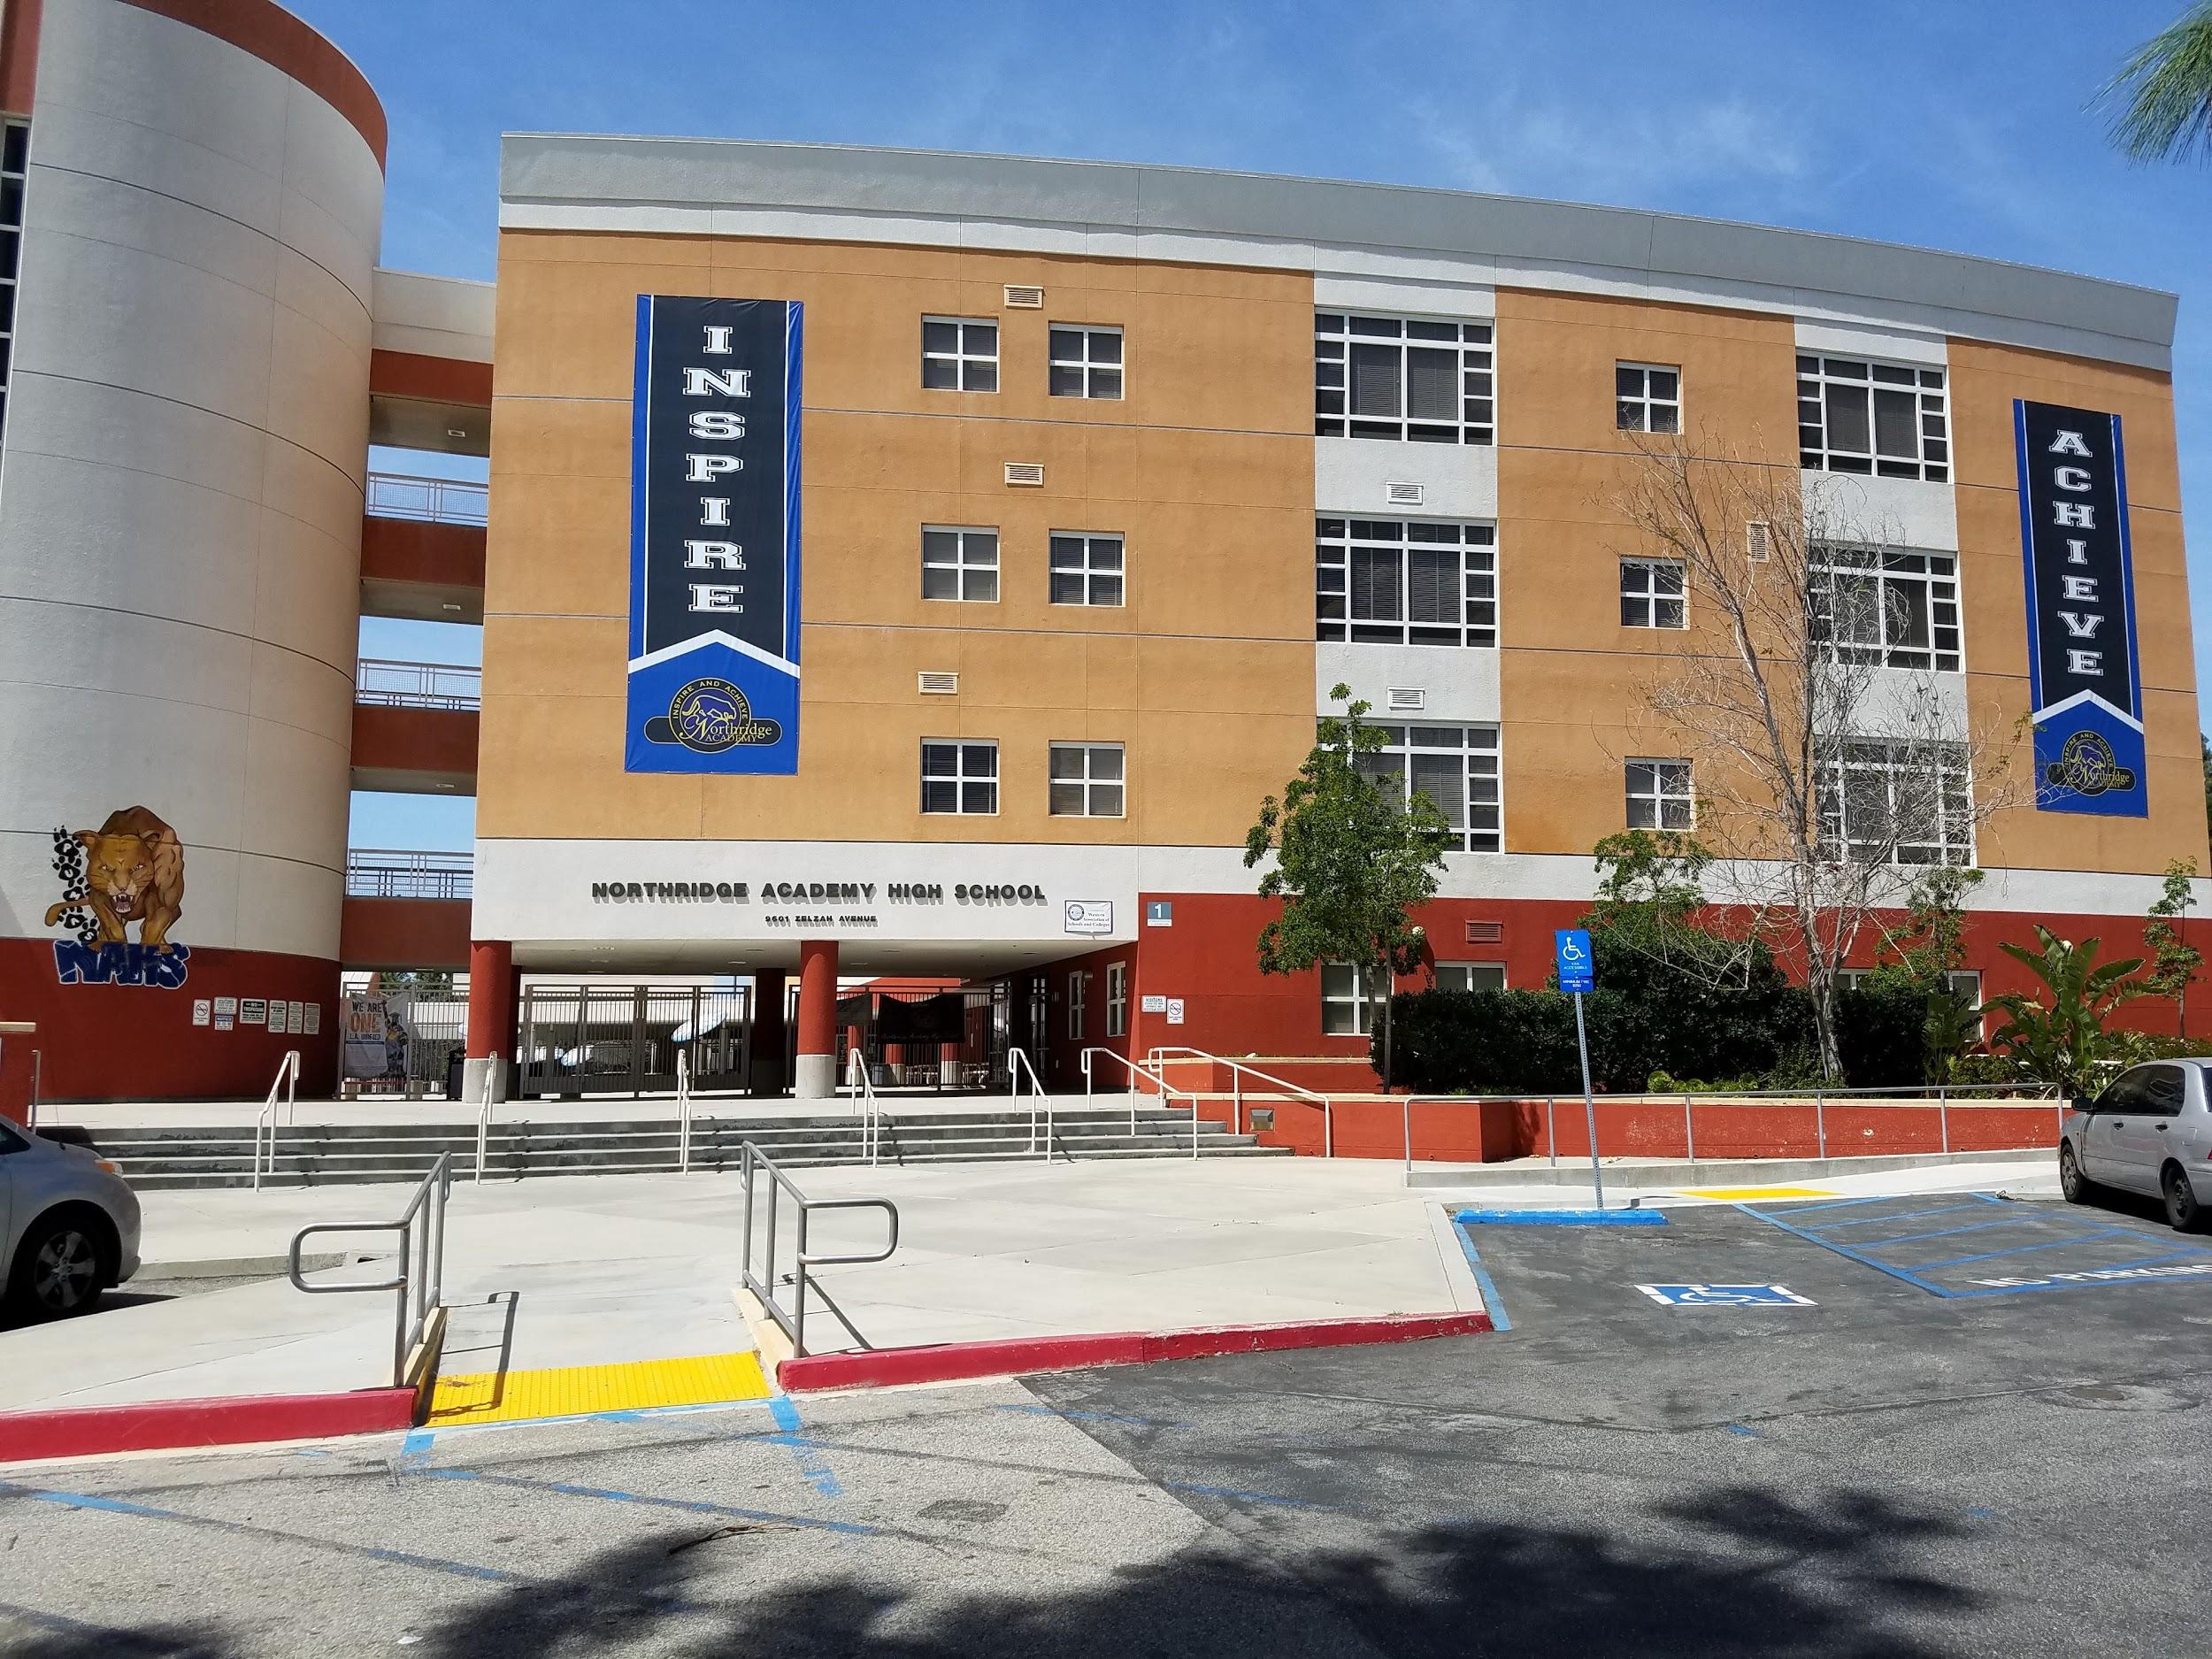
Go NAHS!

