Slide 1
Chatsworth park urban planning magnet school
Legacy project:
PBL Projects

Slide 2
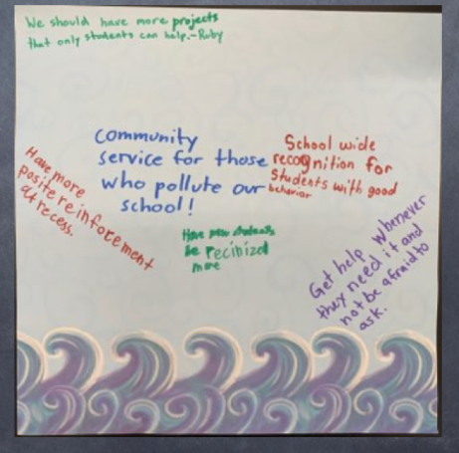
Legacy mission
Our teachers solicit students’ ideas and opinions to understand students’ perspectives and experiences. The students’ input is valued and supports the learning process within PBL as well as the learning environment. Our Students actively listen to their peers, and they respect and value different opinions and viewpoints. Teachers foster an environment where students learn from each other’s voice and aspirations.

Slide 3
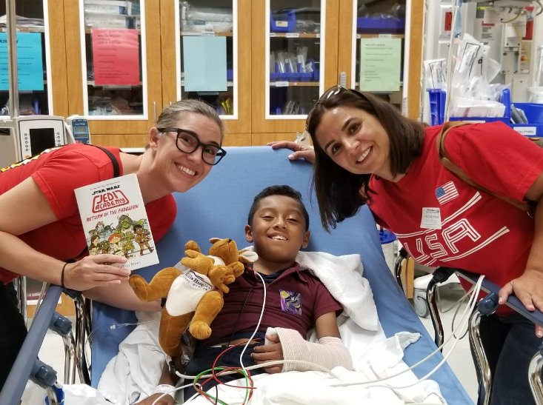
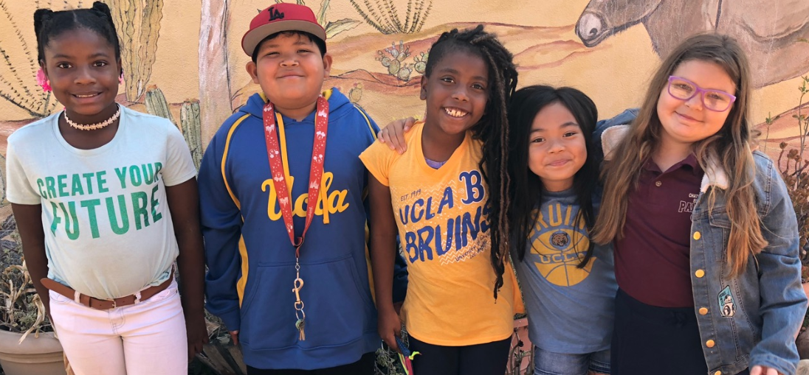
School of action
- Where every voice matters -

Slide 4
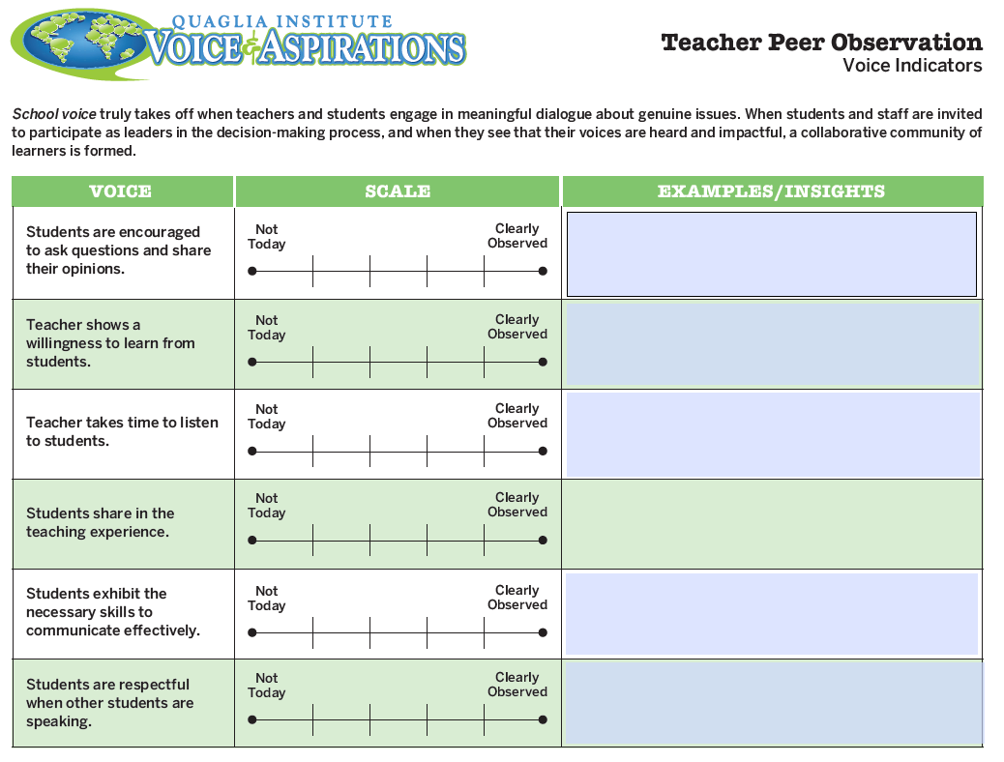
Awareness paves the path for future aspirations
School voice truly takes off when teachers and students engage in meaningful dialogue about genuine issues. When students and staff are invited to participate as leaders in the decision-making process, and when they see that their voices are heard and impactful, a collaborative community of learners is formed.

Slide 5
Student Voice within project baseD Learning
The 8 Conditions That
Make a Difference
Belonging
“I feel important in my classroom.”
Heroes
“Teachers/facilitators respect me.”
Sense of Accomplishment
“I give my best effort at school.”
Fun & Excitement
“Learning can be fun.”
Curiosity & Creativity
“I enjoy working on projects with other students.”
Spirit of Adventure
“The things I learn in school are important to me.”
Leadership & Responsibility
“Others listen to my ideas”
Confidence to Take Action
“I think I am a good student.”
-STUDENT VOICE SURVEY STATEMENTS GRADES 3-5
Lift up under-engaged voices.
Give students more discussion time to explore and develop their ideas.
Allow for creative expression.
Make lessons personally relevant.
Reward risks and recognize those who speak up.
Encourage debate.

Slide 6
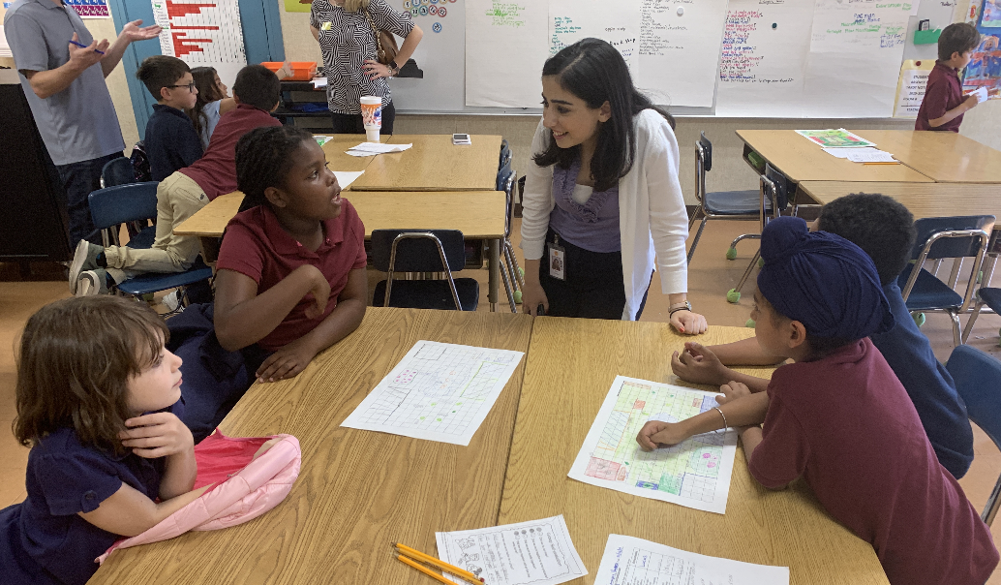
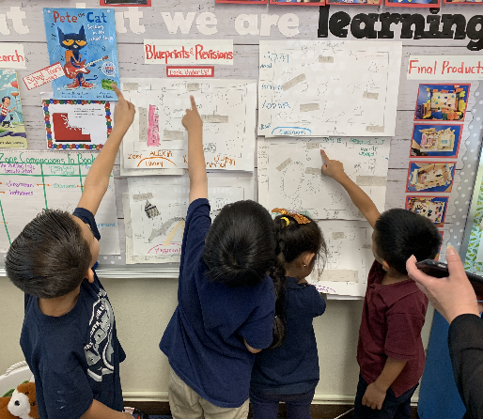
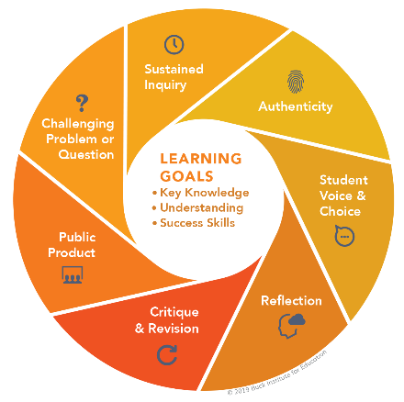
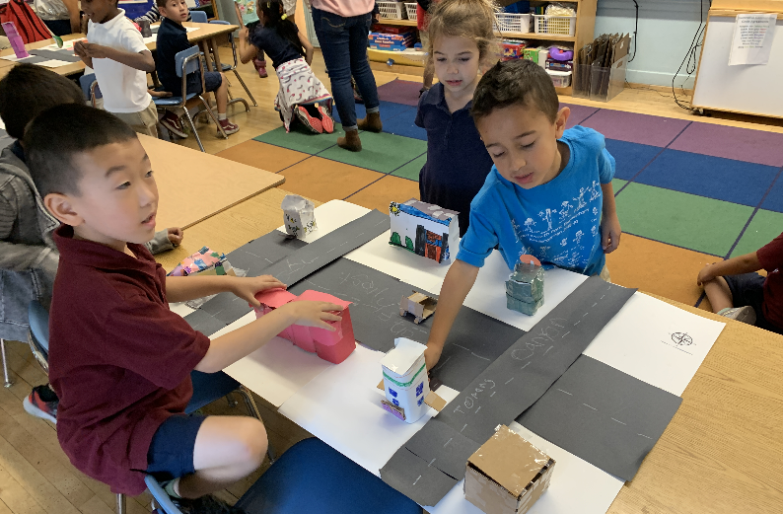
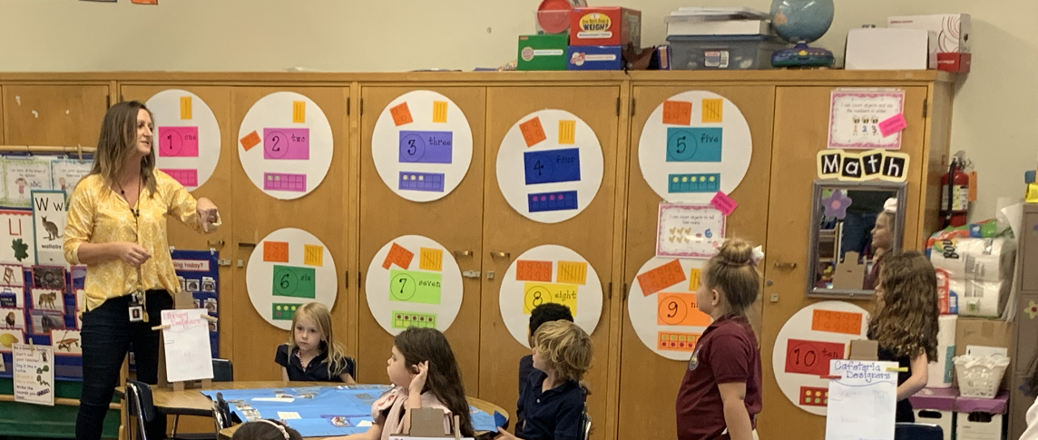
VOICES IN ACTION

Slide 7
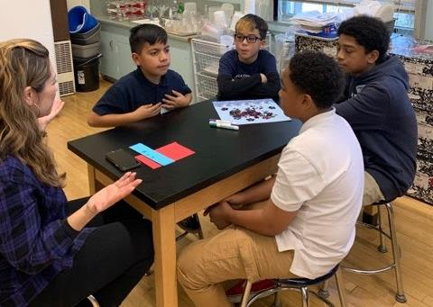
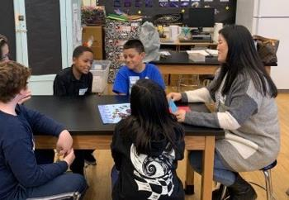
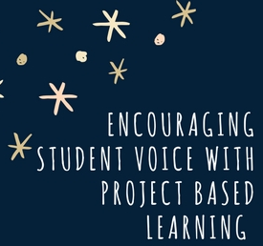
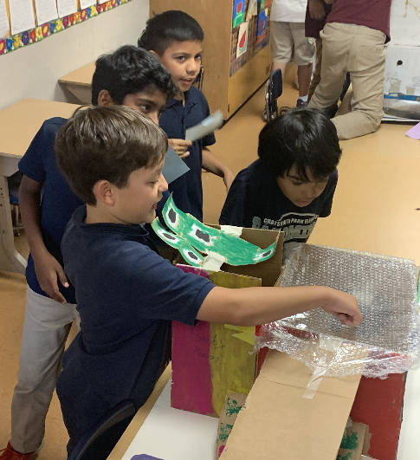
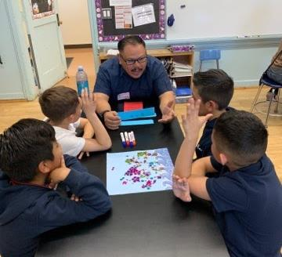
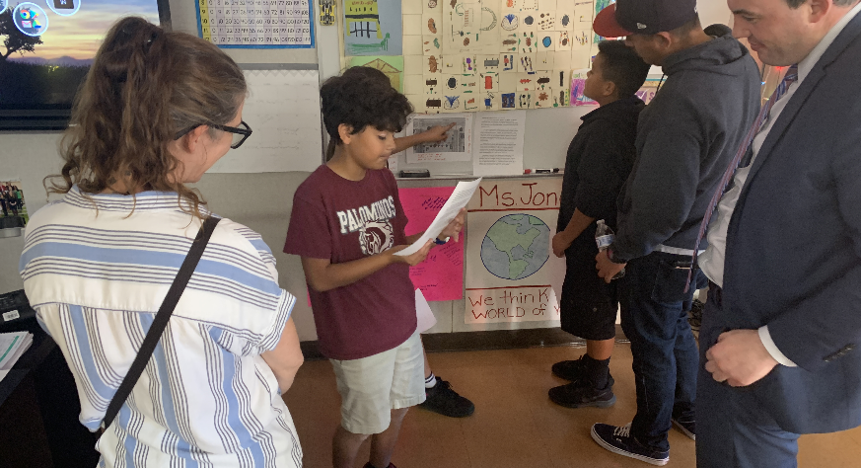
WHOLE-CHILD ASPIRATIONS

