Slide 1
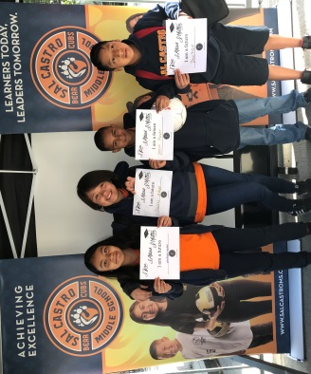
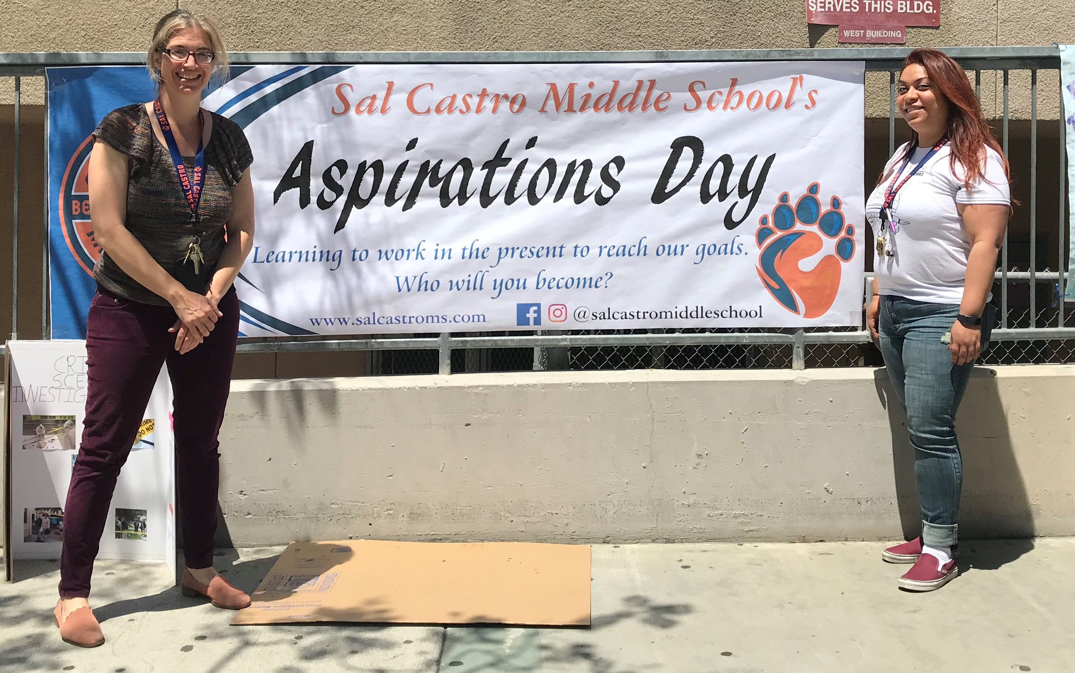
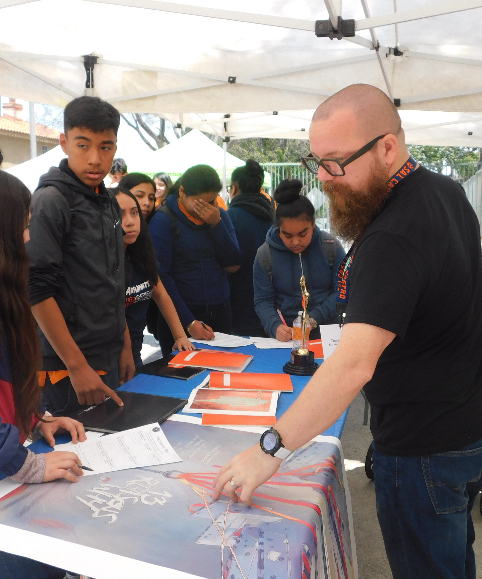
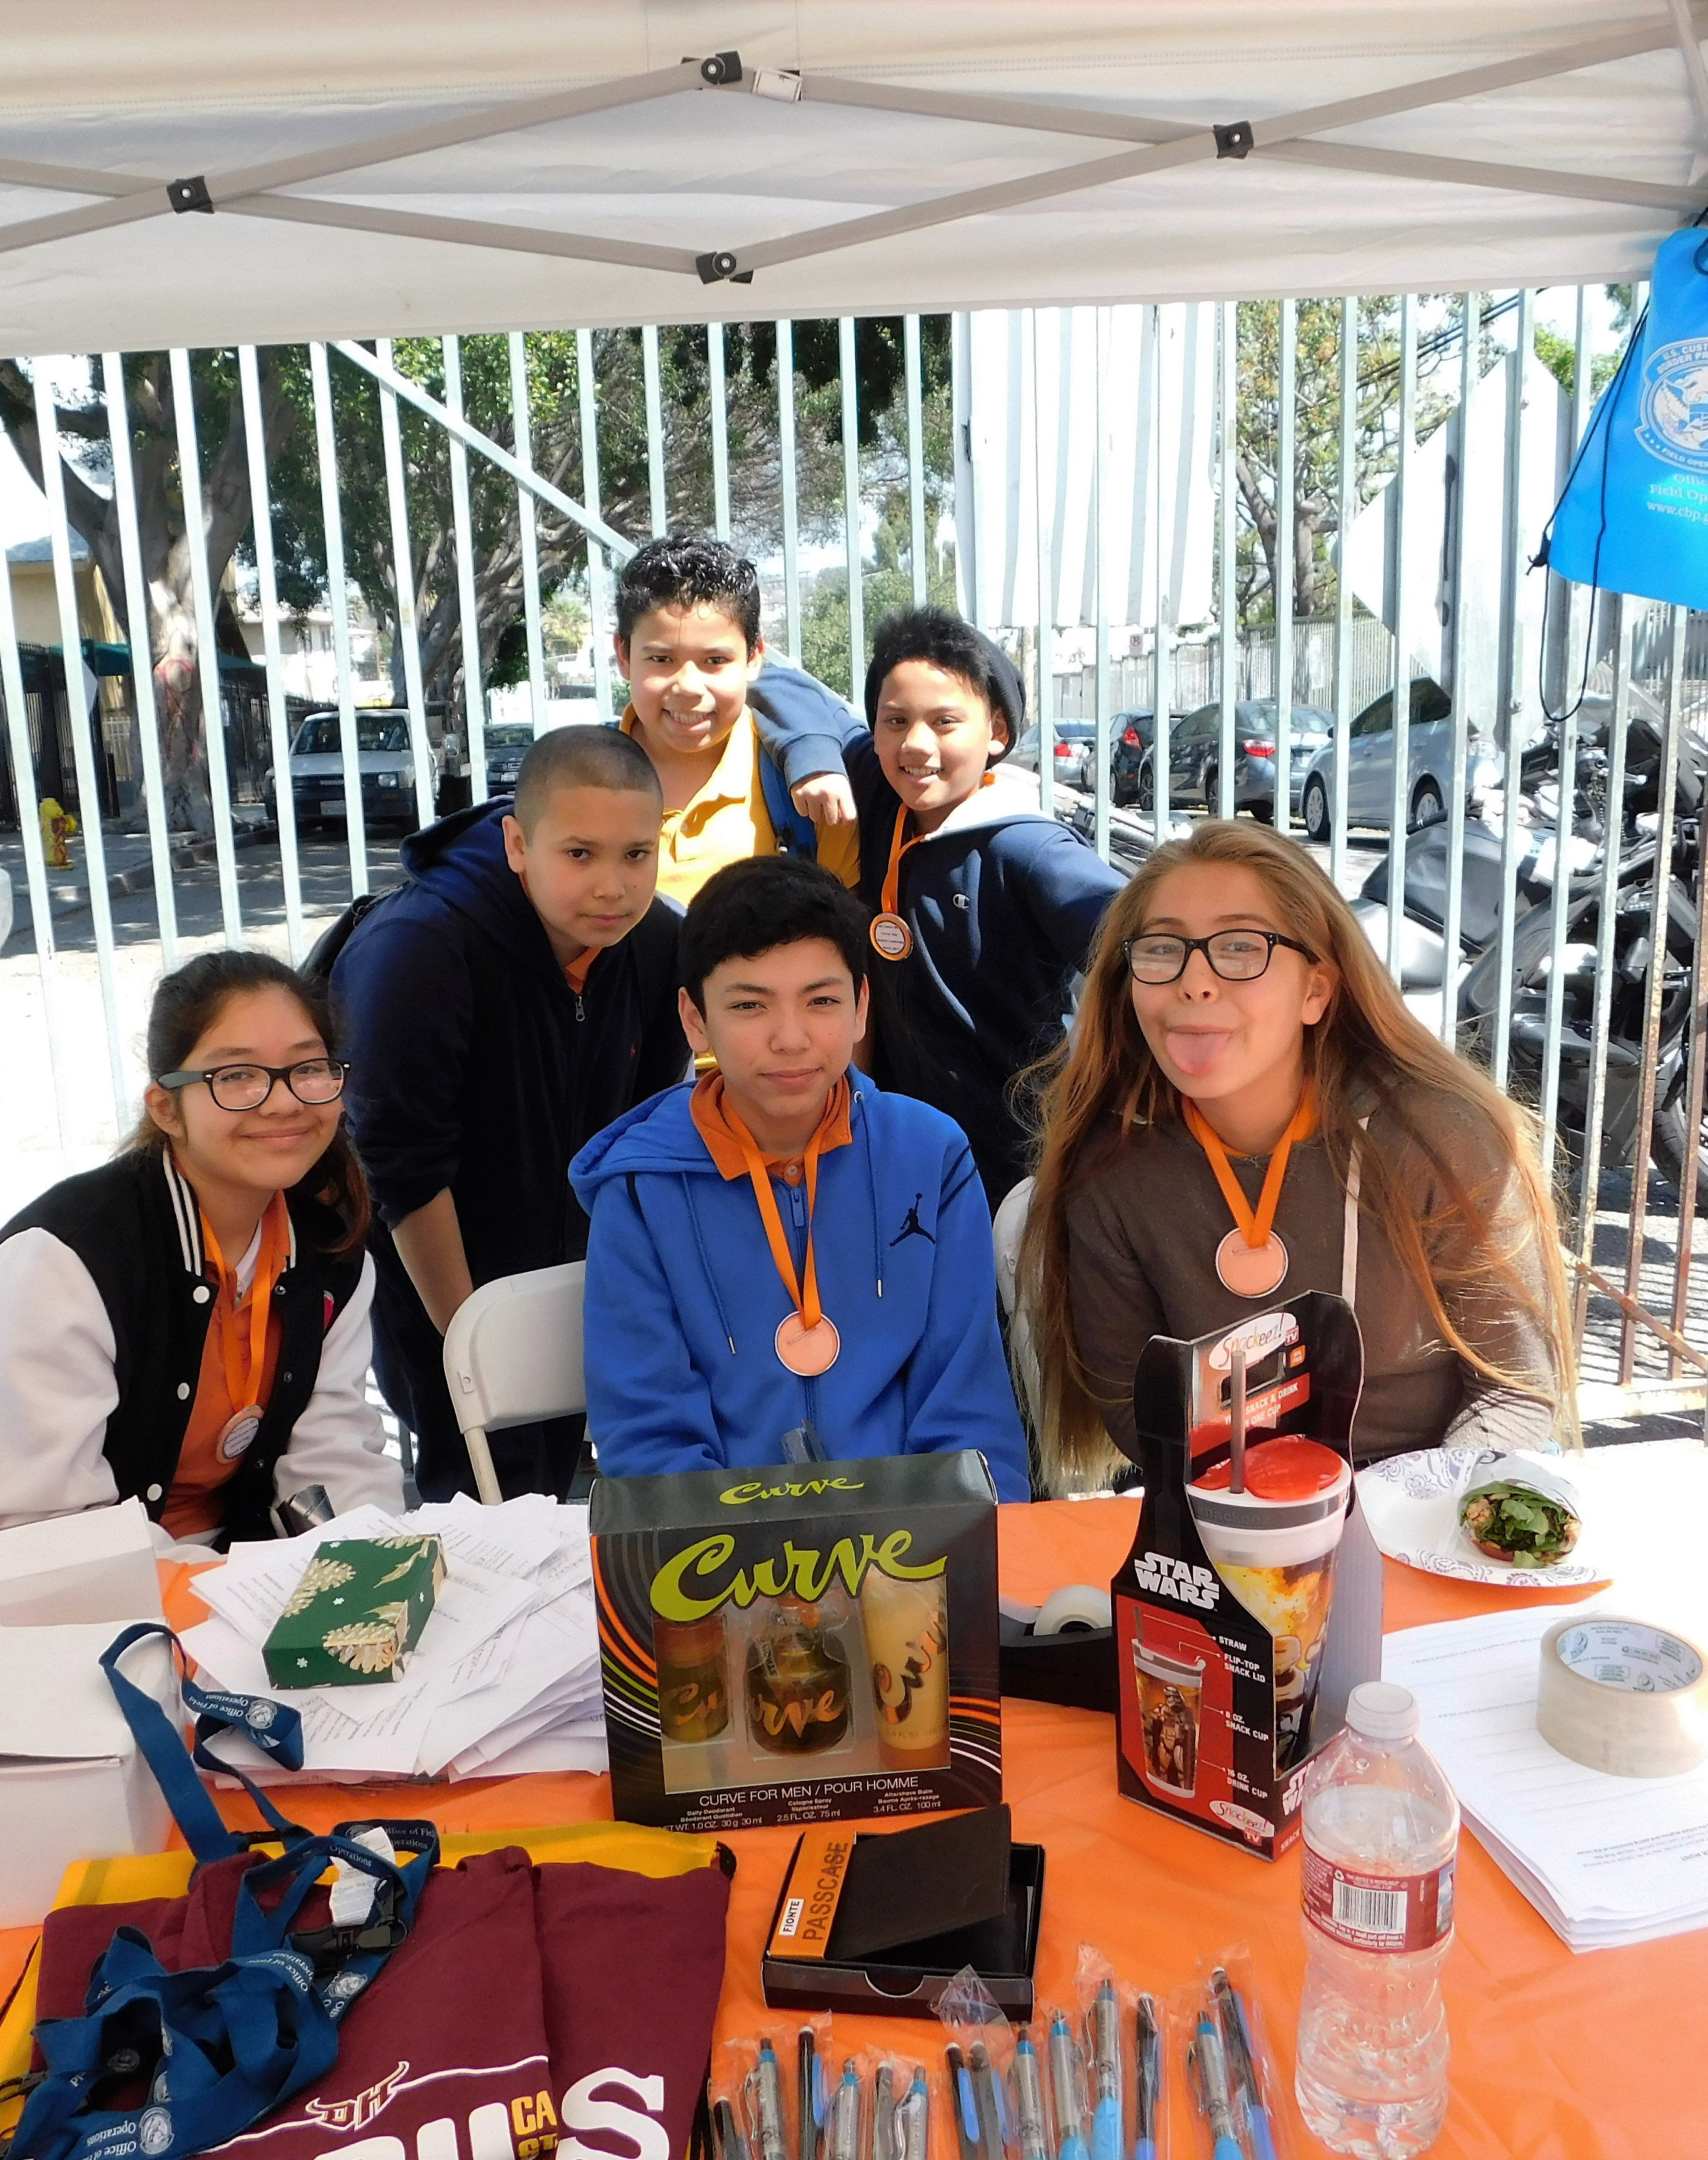
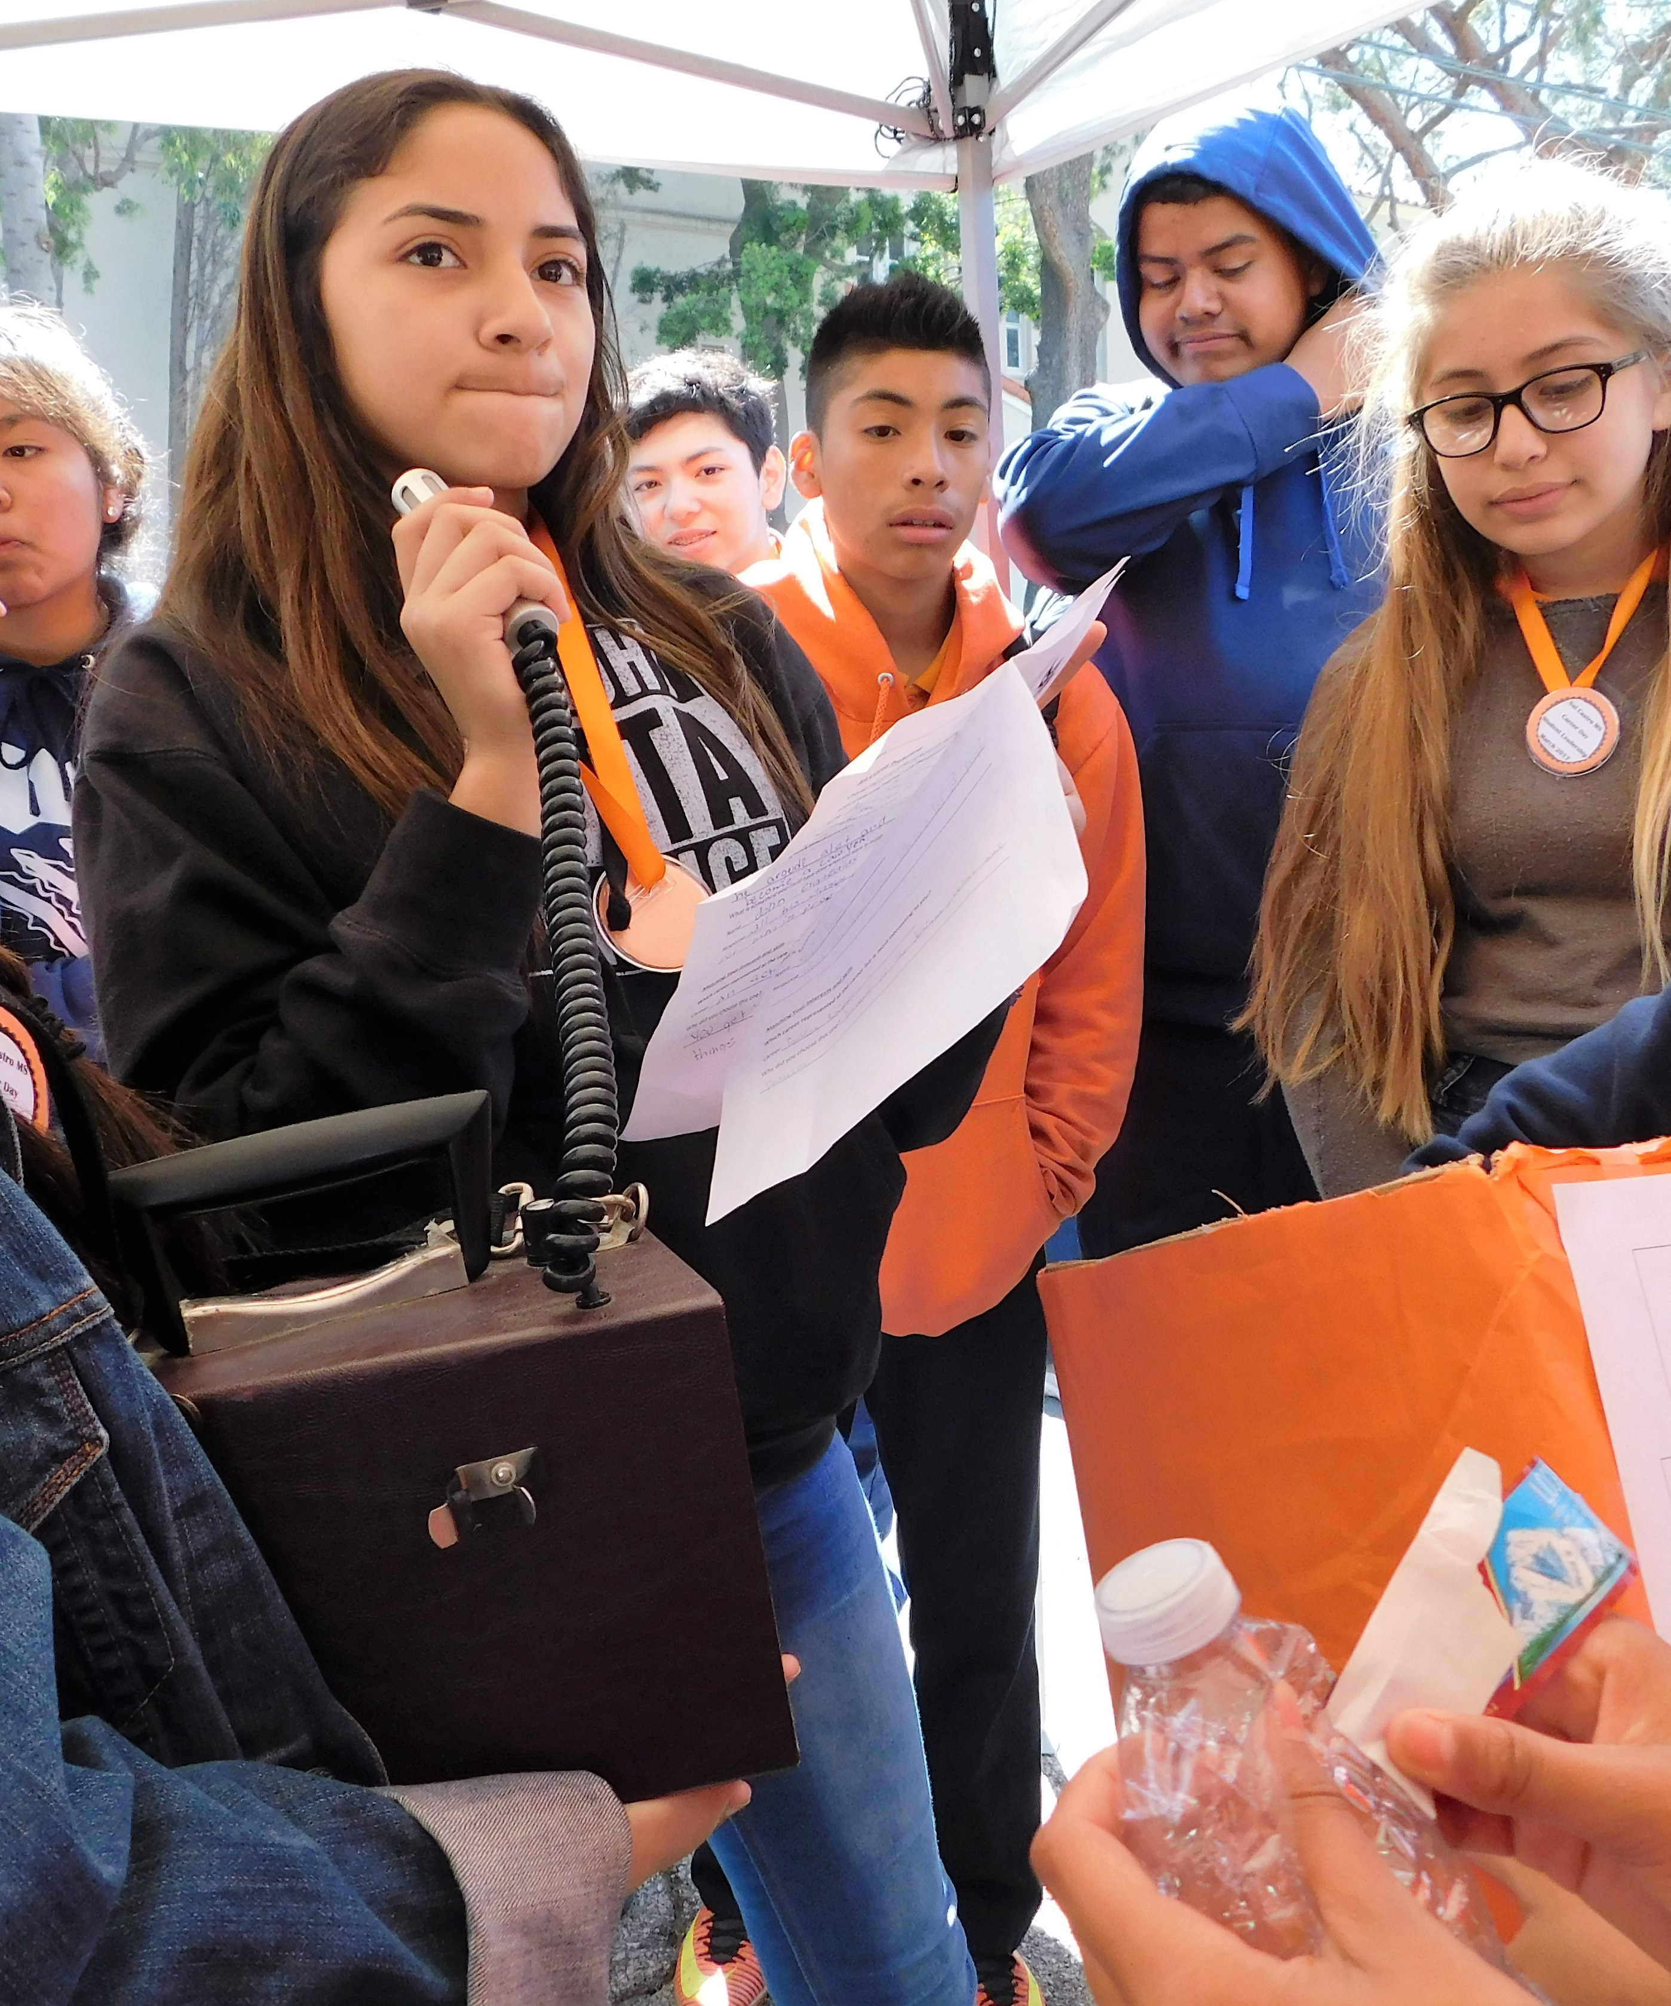
Sal Castro Middle School
Legacy Project:
Aspirations Day

Slide 2
How do we transform our traditional Career Day into an event that truly incorporates Student Voice and all we’ve learned from the Quaglia Institute?

Slide 3
Overview of Aspirations Day
Castro’s take on a traditional Career Day
An all-school career exploration event that takes place toward the end of the school year that encourages students to think about what kind of people they would like to become, as well as what career they might pursue
Culmination of a program of activities designed to help students develop a stronger sense of their values, personality traits, skills and goals
Involves students, families and the community

Slide 4
How Does Aspirations Day Incorporate Student Voice?
We seek student input while planning the event
We invite students to be members of the planning team
Students help with implementation of the event
Professionals who participate are guided to not only share about the activities and preparation for their careers, but also to include related values, skills and personality traits that have led them to and have helped them be successful in their careers

Slide 5
Aspirations Day Outcomes
Students develop deeper sense of self
Students develop clearer aspirations as measured by the Student Voice Survey
Students are increasingly involved in the planning and implementation of Aspirations Day

Slide 6
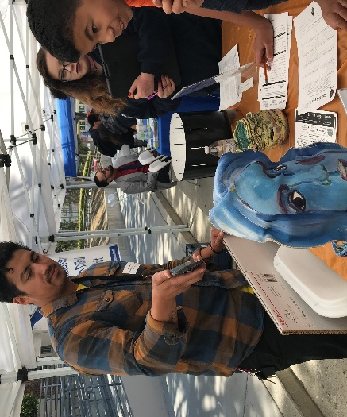
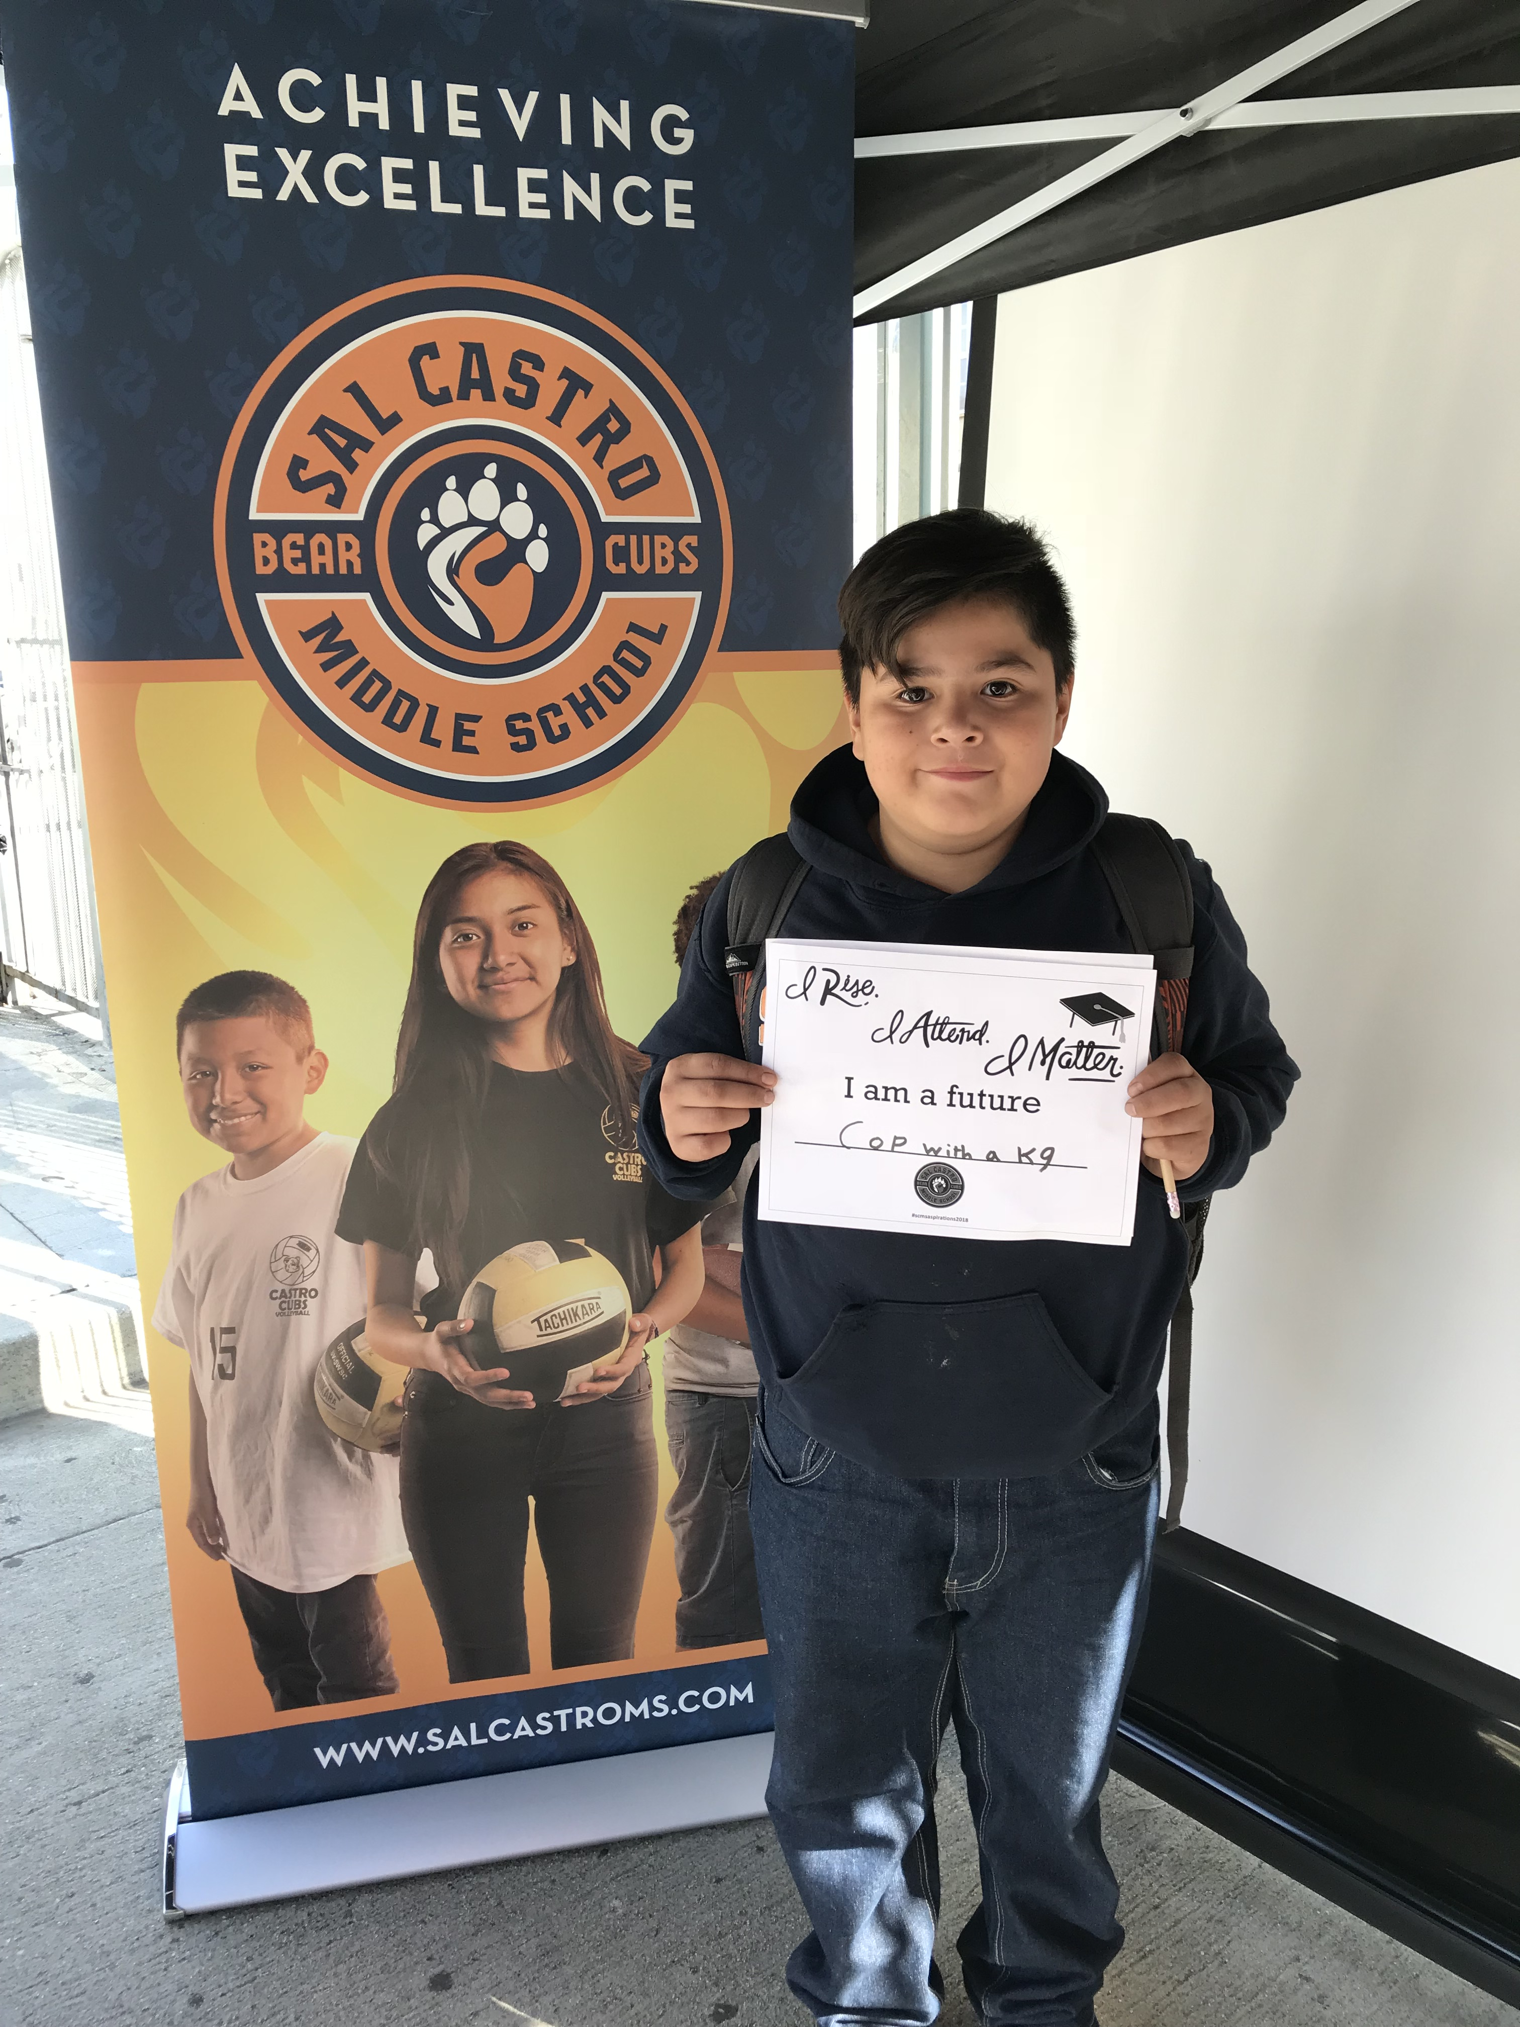
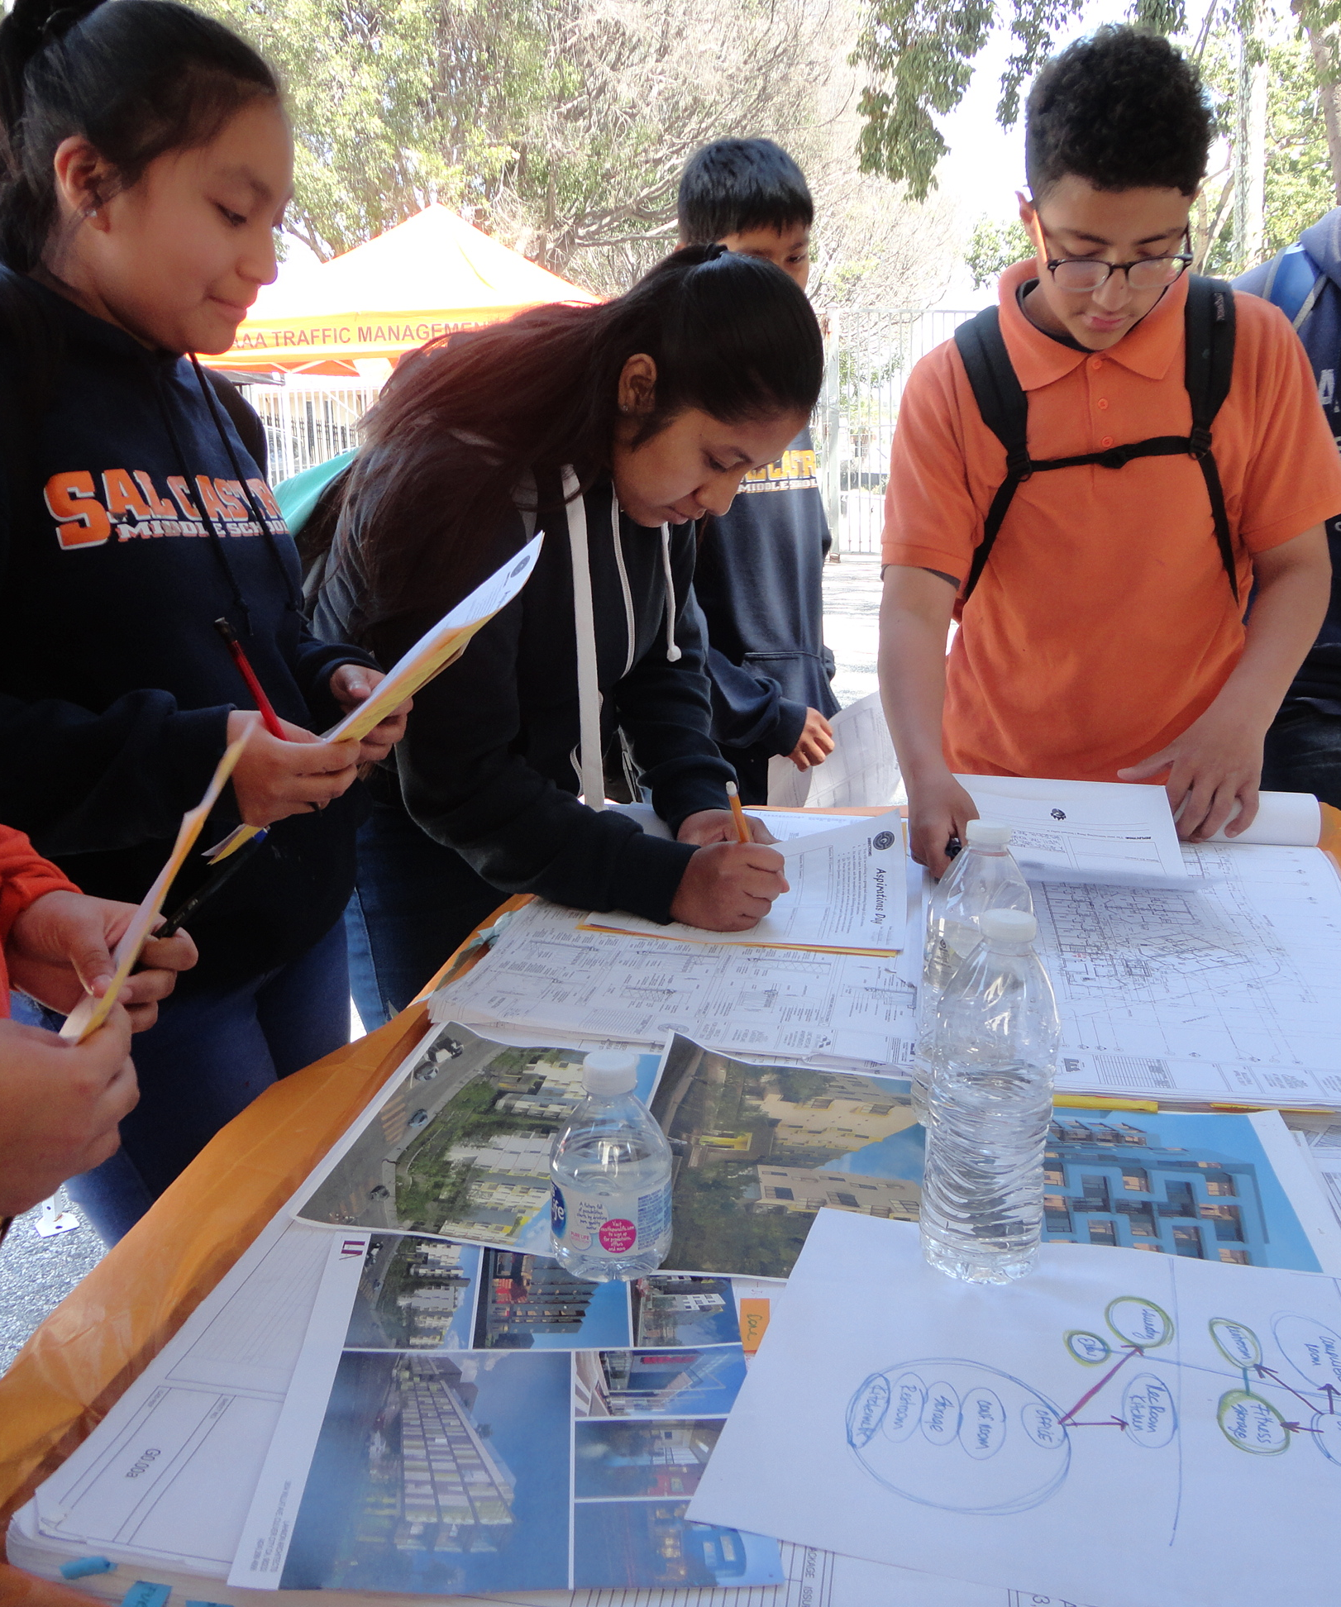
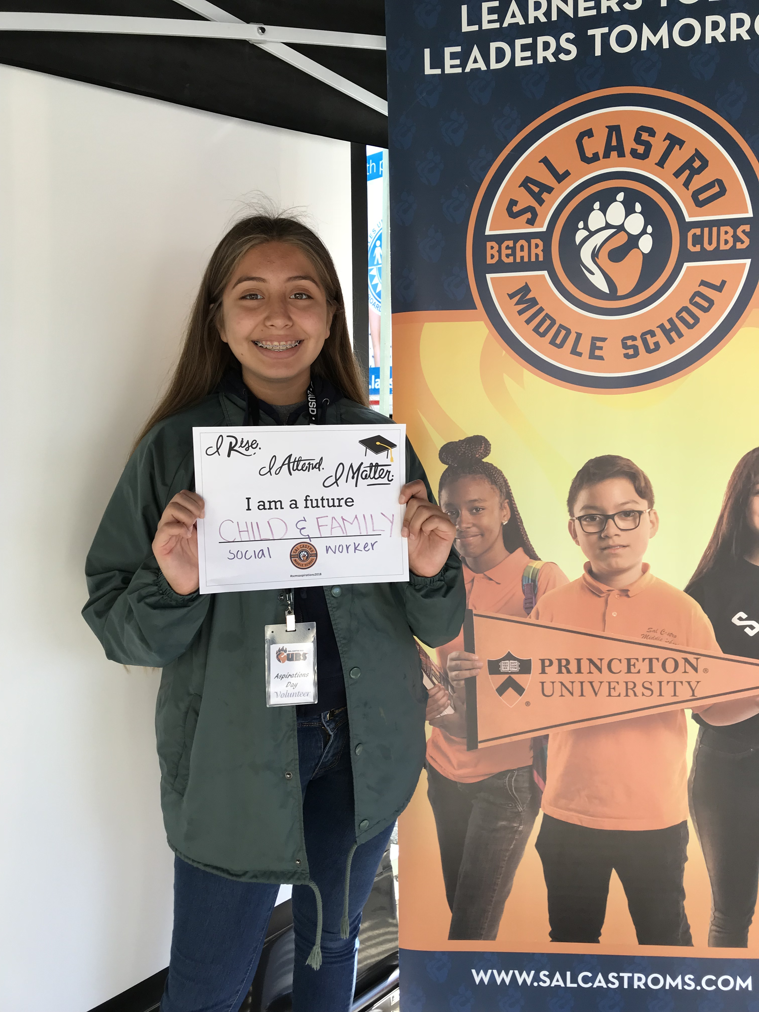
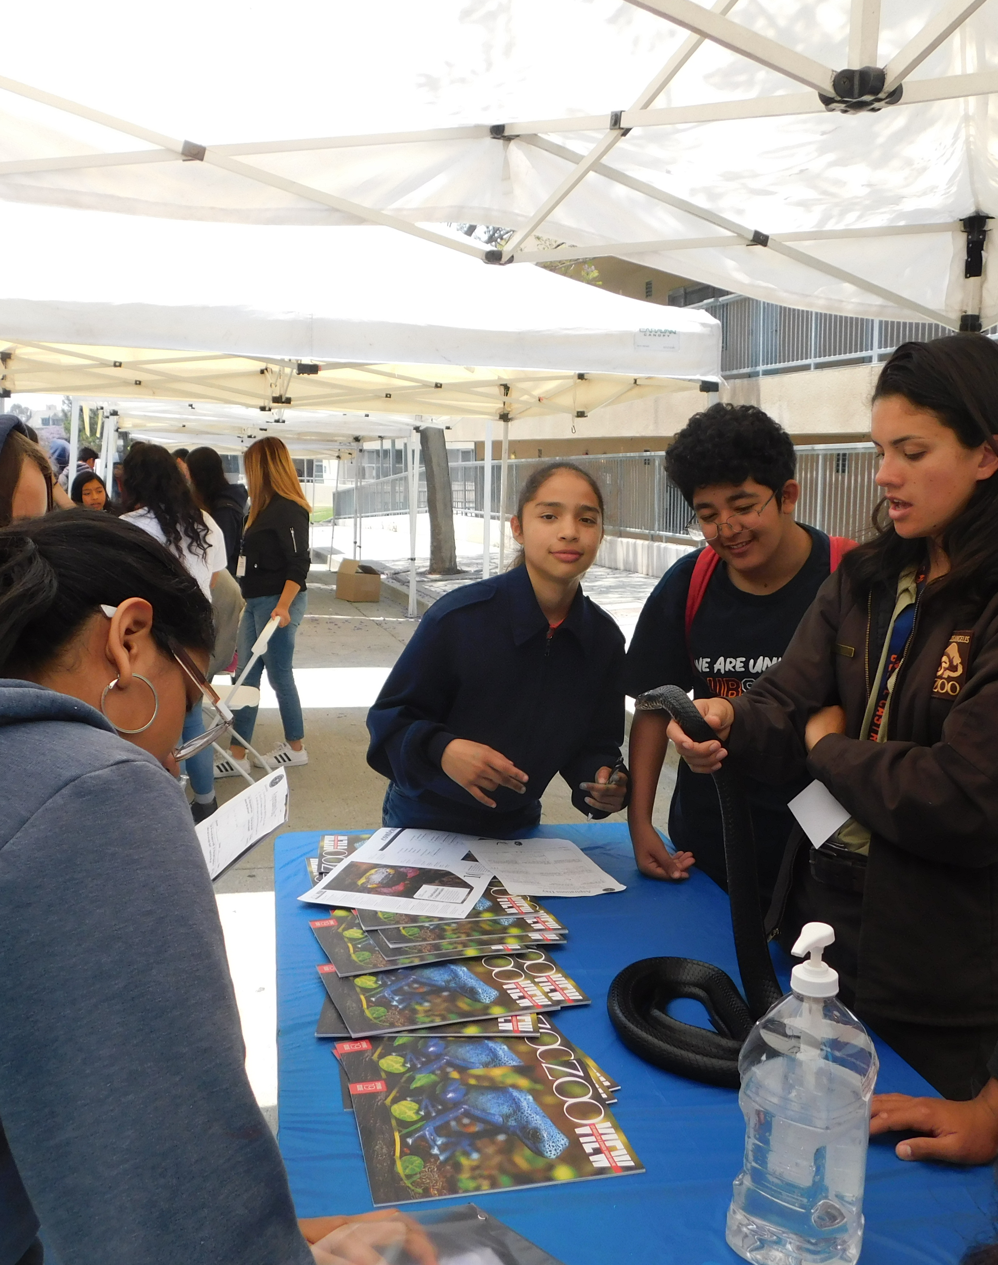
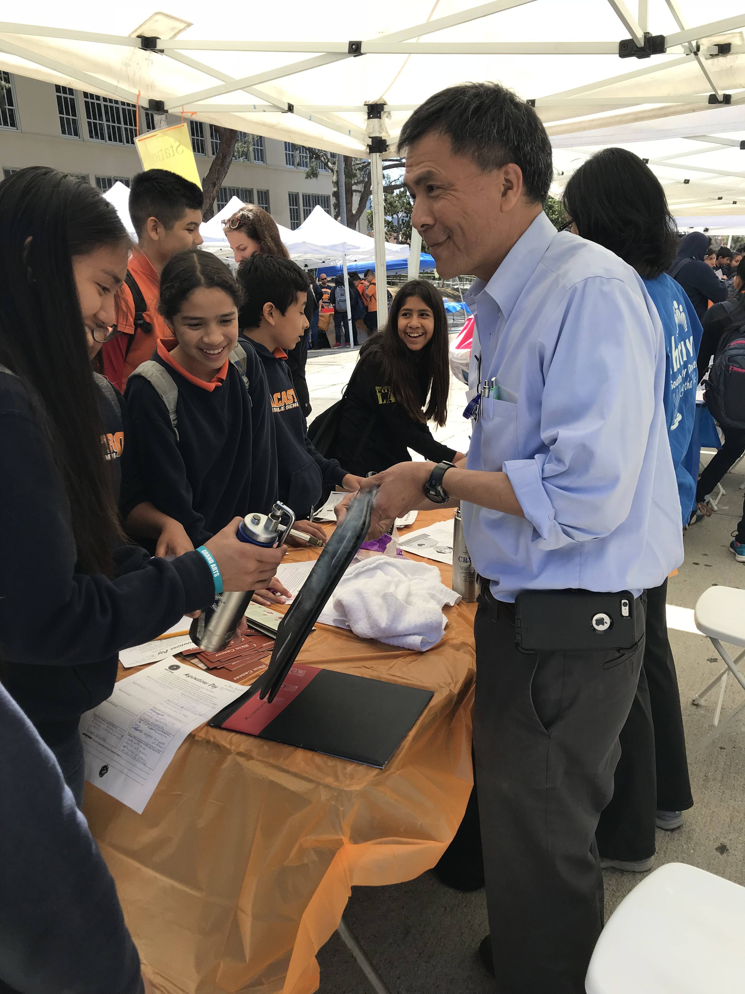
Evidence

Slide 7

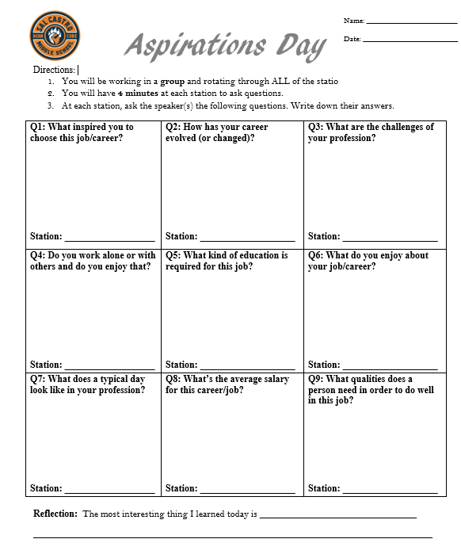
Evidence
Student Voice Interest Survey
https://docs.google.com/forms/d/e/1FAIpQLSciMUENX3k2sJLomenHimwpWKll8ftP1Yc5WyoxgwJA9PhAGQ/viewform

Slide 8
Next Steps
Use Advisory class to engage students in self-exploration activities that encourage reflection on their values, interests, personality traits and goals. These activities would occur periodically throughout the school year. Aspirations Day would then be the culminating activity for this year of exploration.
Open the Aspirations Day planning team to all students, rather than just Leadership or AVID students, and adjust the ratio of students to adults on the planning team (i.e., include more students) in order to amplify student voice in the event planning.
Provide a pre-event survey to the professionals that solicits some personal information (for example, 3 words that describe you, a defining moment that led you to choose your profession) that could be highlighted during the event (for example, each booth could have the person’s responses in a visual format so that students could be reading information as well as interacting with the professionals)
Make a more explicit attempt to Incorporate the 8 Conditions of Student Voice into all of the Aspiration Day activities

Slide 9
